Slide 1
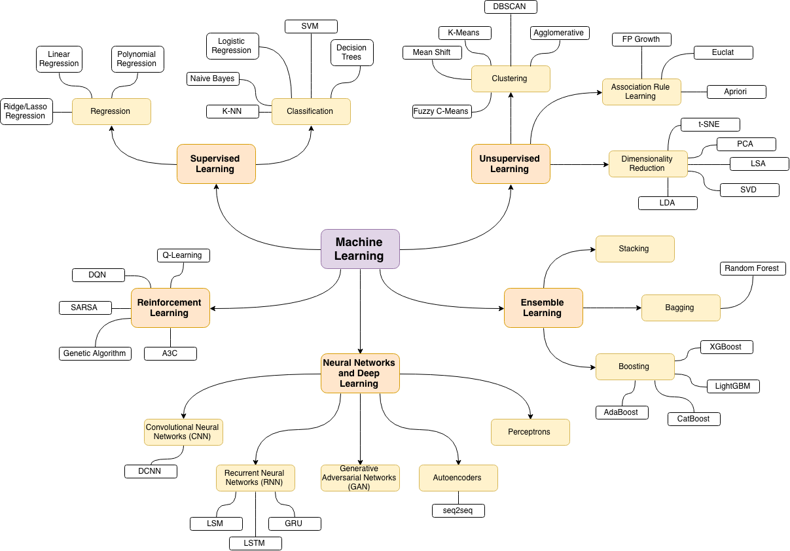
Classification and Regression Trees (CART)

Slide 2

COVID-19 Decision Tree

Slide 3
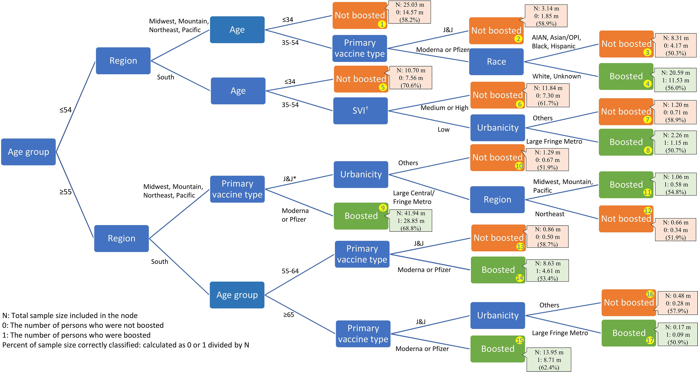
Classification tree diagram depicting demographic characteristics associated with COVID-19 booster vaccination among adults completing the primary series before September 15, 2021, by social demographic factors, March 15, 2022, United States.
A tree model identified adults age ≤34 years, Johnson & Johnson primary series recipients, people from racial/ethnic minority groups, residents of nonlarge metro areas, and those living in socially vulnerable communities in the South as less likely to be boosted. These findings can guide clinical/public health outreach toward specific subpopulations.

Slide 4
Description of sample sizes and prediction rates for all 17 end nodes in the figure
 | Sample size | Boosted | Not boosted | Prediction rate
End node 1 - Not boosted | 25,033,103 | 10,458,113 | 14,574,990 | 58.2
End node 2 - Not boosted | 3,141,734 | 1,291,619 | 1,850,115 | 58.9
End node 3 - Not boosted | 8,305,391 | 4,127,749 | 4,177,642 | 50.3
End node 4 - Boosted | 20,590,905 | 11,525,934 | 9,064,971 | 56.0
End node 5 - Not boosted | 10,701,064 | 3,145,273 | 7,555,791 | 70.6
End node 6 - Not boosted | 11,842,463 | 4,539,546 | 7,302,917 | 61.7
End node 7 - Not boosted | 1,200,760 | 493,489 | 707,271 | 58.9
End node 8 - Boosted | 2,259,617 | 1,145,417 | 1,114,200 | 50.7
End node 9 - Boosted | 41,941,393 | 28,853,266 | 13,088,127 | 68.8
End node 10 - Not boosted | 1,288,959 | 620,087 | 668,872 | 51.9
End node 11 - Boosted | 1,058,899 | 580,677 | 478,222 | 54.8
End node 12 - Not boosted | 661,896 | 318,336 | 343,560 | 51.9
End node 13 - Not boosted | 857,600 | 353,786 | 503,814 | 58.7
End node 14 - Boosted | 8,634,501 | 4,608,777 | 4,025,724 | 53.4
End node 15 - Boosted | 13,946,860 | 8,708,761 | 5,238,099 | 62.4
End node 16 - Not boosted | 479,072 | 201,772 | 277,300 | 57.9
End node 17 - Boosted | 172,023 | 87,567 | 84,456 | 50.9
Total | 152,116,240 | 81,060,169 | 71,056,071 | 61.5
Source: https://academic.oup.com/ofid/article/9/9/ofac446/6679703

Slide 5
Trees and Rules
Goal: Classify or predict an outcome based on a set of predictors
The output is a set of rules
Example:
Goal: classify a record as “will accept credit card offer” or “will not accept”
Rule might be “IF (Income > 110.5) AND (Education <= 1.5) AND (Family <= 2.5) THEN Class = 0 (non-acceptor).
Also called CART, Decision Trees, or just Trees.
Rules are represented by tree diagrams.
Simple to explain and use!

Slide 6
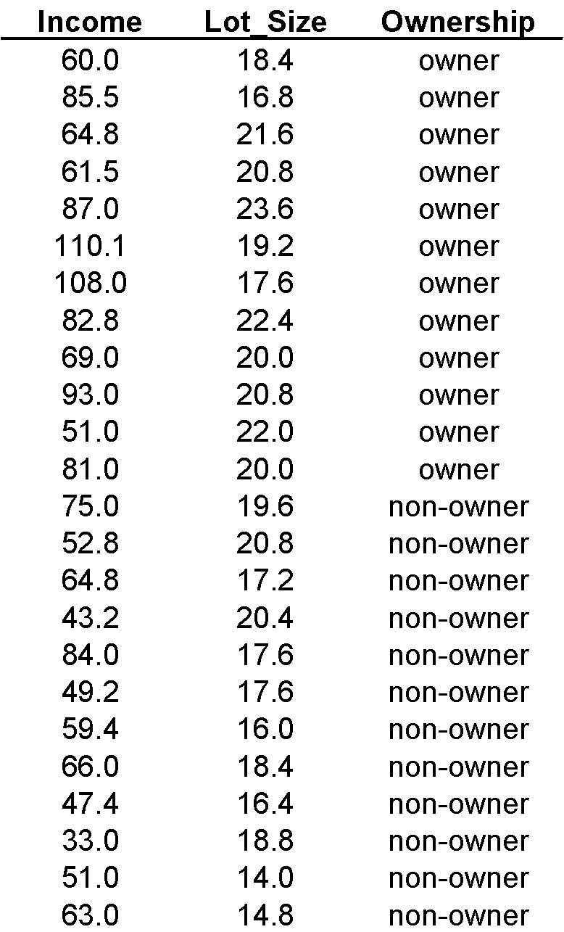
Example: Riding Mowers
Goal: Classify families into
those likely to purchase
a riding mower and
those not likely to
purchase one
Predictors:
Income, Lot Size

Slide 7
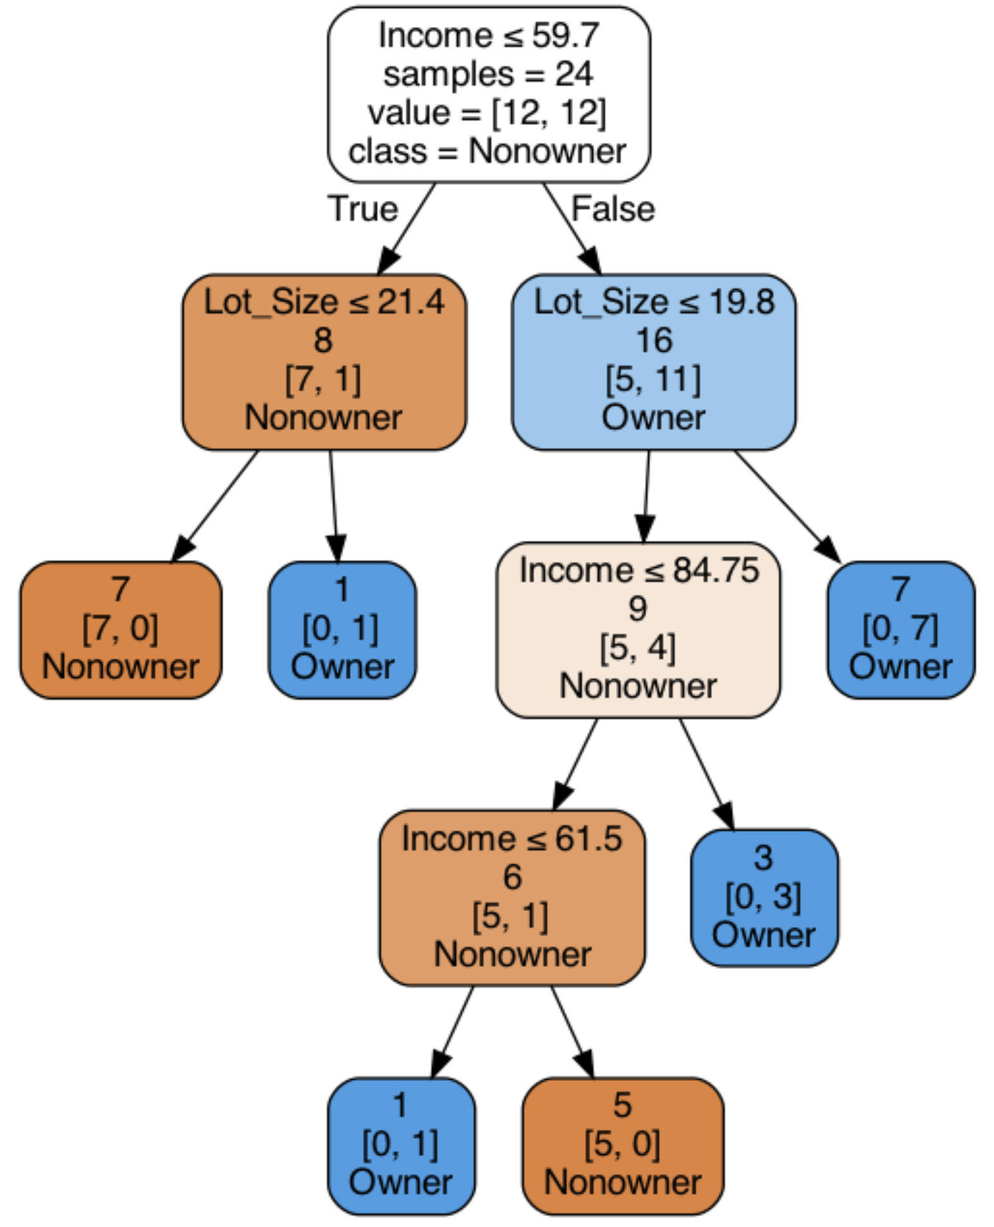

Slide 8
How Is the Tree Produced?
Recursive partitioning: repeatedly split the records into two parts so as to achieve maximum homogeneity of outcome within each new part, i.e., growing the tree.
Stopping Tree Growth: a fully grown tree is too complex and will overfit, i.e., pruning the tree.

Slide 9
Recursive Partitioning - Growing the Tree

Slide 10
Recursive Partitioning
- Order records according to one predictor, say income
- Take a predictor value, say 59.7 (average of 59.4 and 60) and divide records into those with income <= 59.7 and those > 59.7
- Measure resulting purity (homogeneity) of class in each resulting portion
- Try all other split values
- Repeat for other predictor(s)
- Select the one predictor and split that yields the most purity

Slide 11
How to select a particular split?
- Examine each predictor and all possible split values for each predictor to find the best split
- Split values for a variable are the midpoints (averages) between pairs of consecutive values for the predictor
- The possible split points for Income are {38.1, 45.3, 50.1, ..., 109.5} and those for Lot Size are {14.4, 15.4, 16.2, ..., 23}
- These split points are ranked according to how much they reduce impurity (heterogeneity) in the resulting rectangle
- Reduction in impurity is defined as overall impurity before the split minus the sum of the impurities for the two rectangles that result from a split

Slide 12
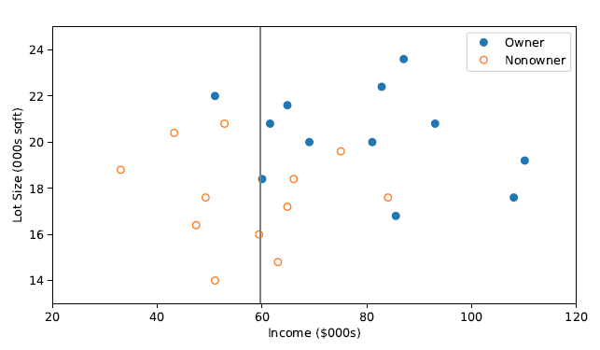
The first split: Income = 59.7

Slide 14
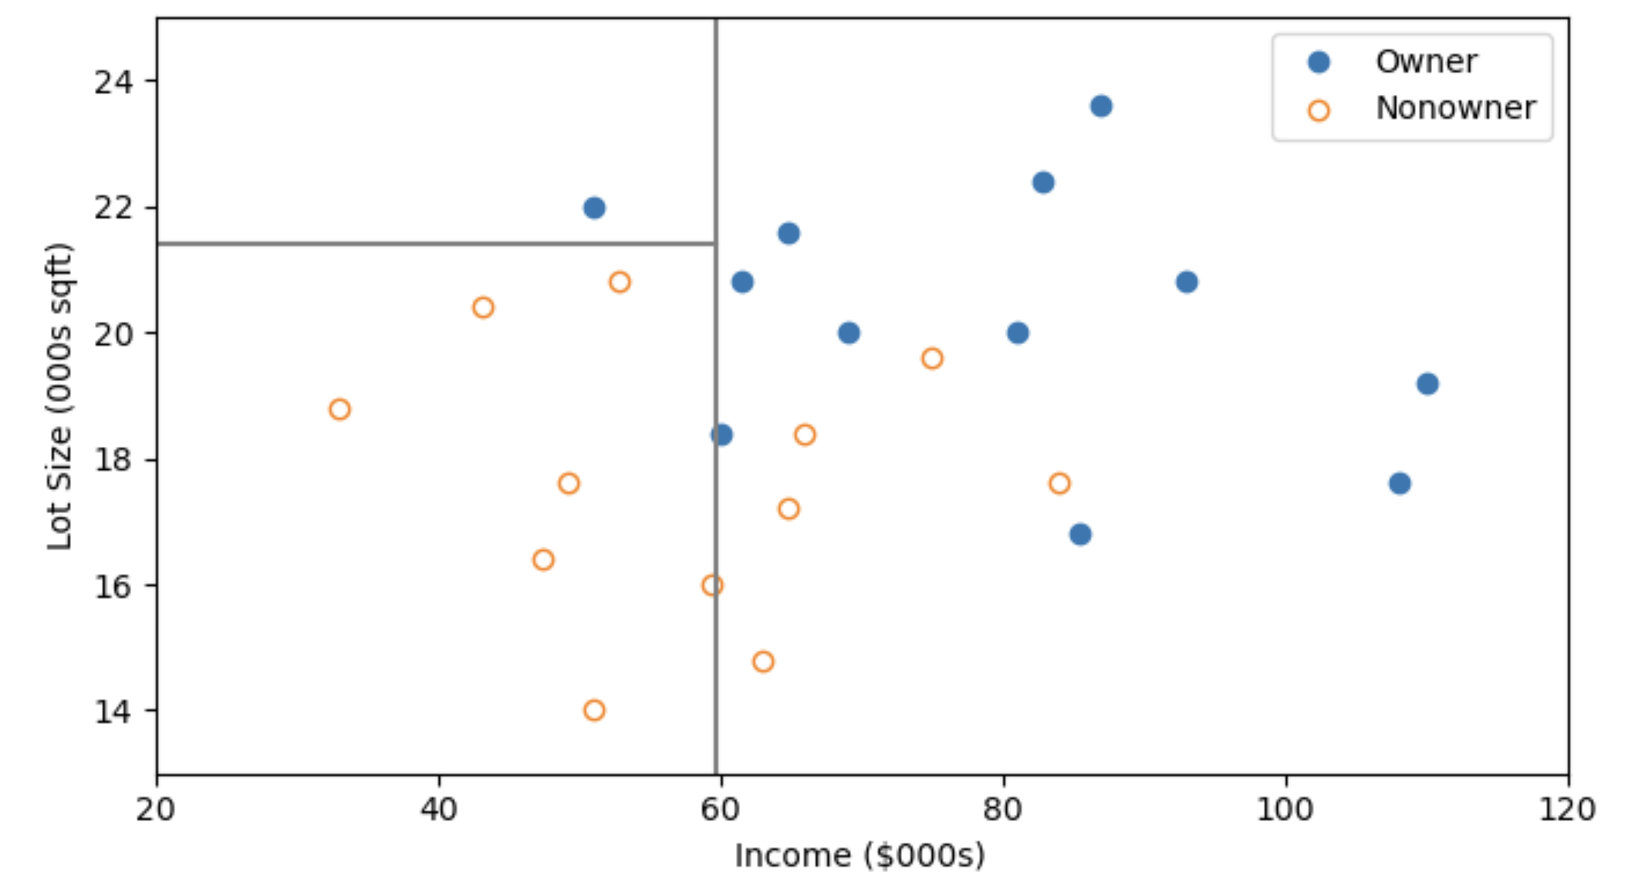
Second Split: Lot size = 21.4

Slide 16
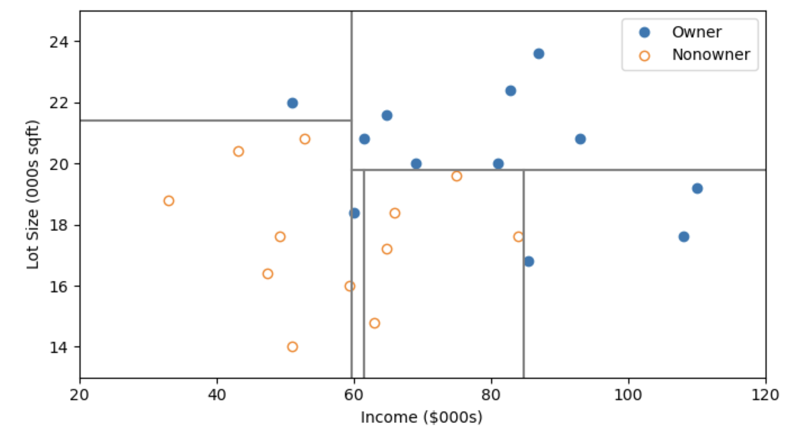
After All Splits

Slide 18
Measuring Impurity

Slide 19
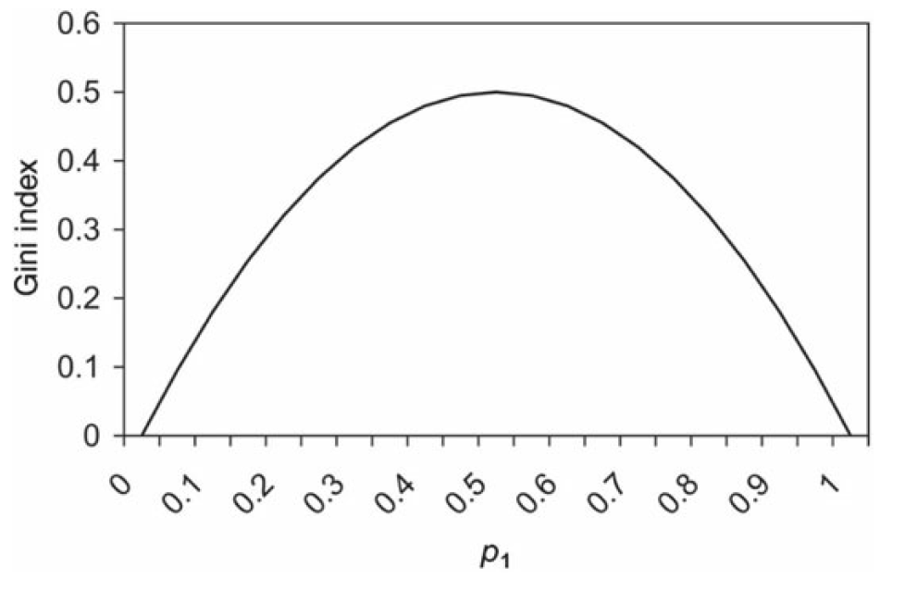
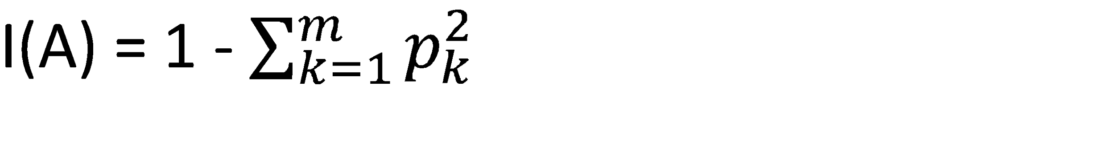
Gini Index
Gini Index for rectangle A
p_{k} = proportion of cases in rectangle A that belong to class k (out of m classes)
Min: I(A) = 0 when all cases belong to same class
Max: I(A) = (m-1)/m, when all classes are equally represented (= 0.5 in binary case)

Slide 20
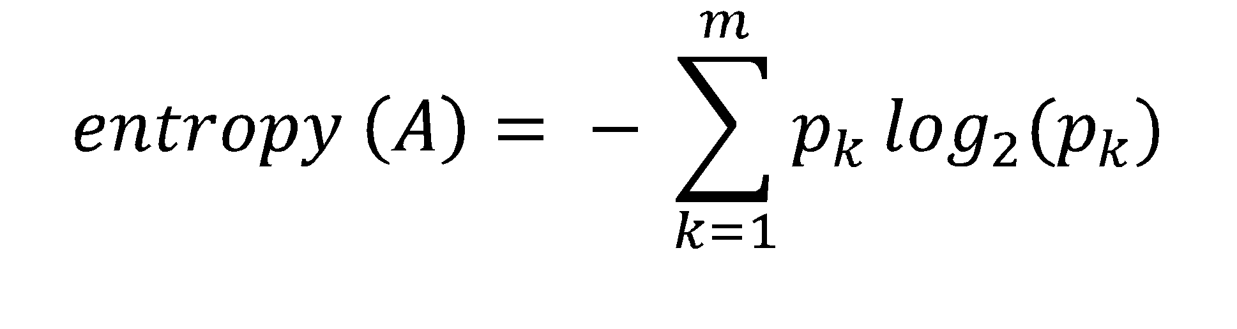
Entropy
p_{k} = proportion of cases in rectangle A that belong to class k (out of m classes)
Entropy ranges between 0 (most pure) and log₂(m) (equal representation of classes)
Maximized at p=0.5 in the two-class case.
(Python: math.log2(x))

Slide 21
Impurity before and after the first split
Gini before split = 1- (0.5)² - (0.5)² = 0.5
Entropy before split = -[(½)log₂(½)+(½)log₂(½)] = 1
Gini_left = 1 - (7/8)² - (1/8)² = 0.219
Gini_right = 1 - (11/16)² - (5/16)² = 0.430
Entropy_left= -[(7/8)log₂(7/8) + (1/8)log₂(1/8)] = 0.544
Entropy_right= - [(11/16)log₂(11/16) + (5/16)log₂(5/16)] = 0.896
Gini after split = (8/24)(0.219)+(16/24)(0.430)=0.359
Entropy after split = (8/24)(0.544)+(16/24)(0.896)=0.779

Slide 22
Impurity and Recursive Partitioning
Obtain overall impurity measure (weighted average of individual rectangles)
At each successive stage, compare this measure across all possible splits in all variables
Choose the split that reduces impurity the most
Chosen split points become nodes on the tree

Slide 23
Fit the Classification Tree
mower_df = pd.read_csv('RidingMowers.csv')
# use max_depth to control tree size (None = full tree)
classTree = DecisionTreeClassifier(random_state=1,
max_depth=1)
classTree.fit(mower_df.drop(columns=['Ownership']),
mower_df['Ownership'])
plotDecisionTree(classTree, feature_names=mower_df.columns[:2], class_names=classTree.classes_)
# or use sklearn's tree.plot_tree
fig = plt.figure(figsize=(6,6))
_ = tree.plot_tree(classTree,
feature_names=train_X.columns,
class_names=['Nonowner', 'Owner'],
filled=True)

Slide 24
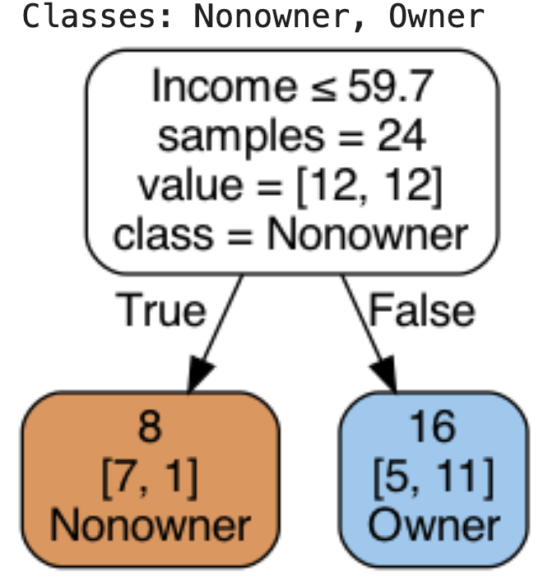
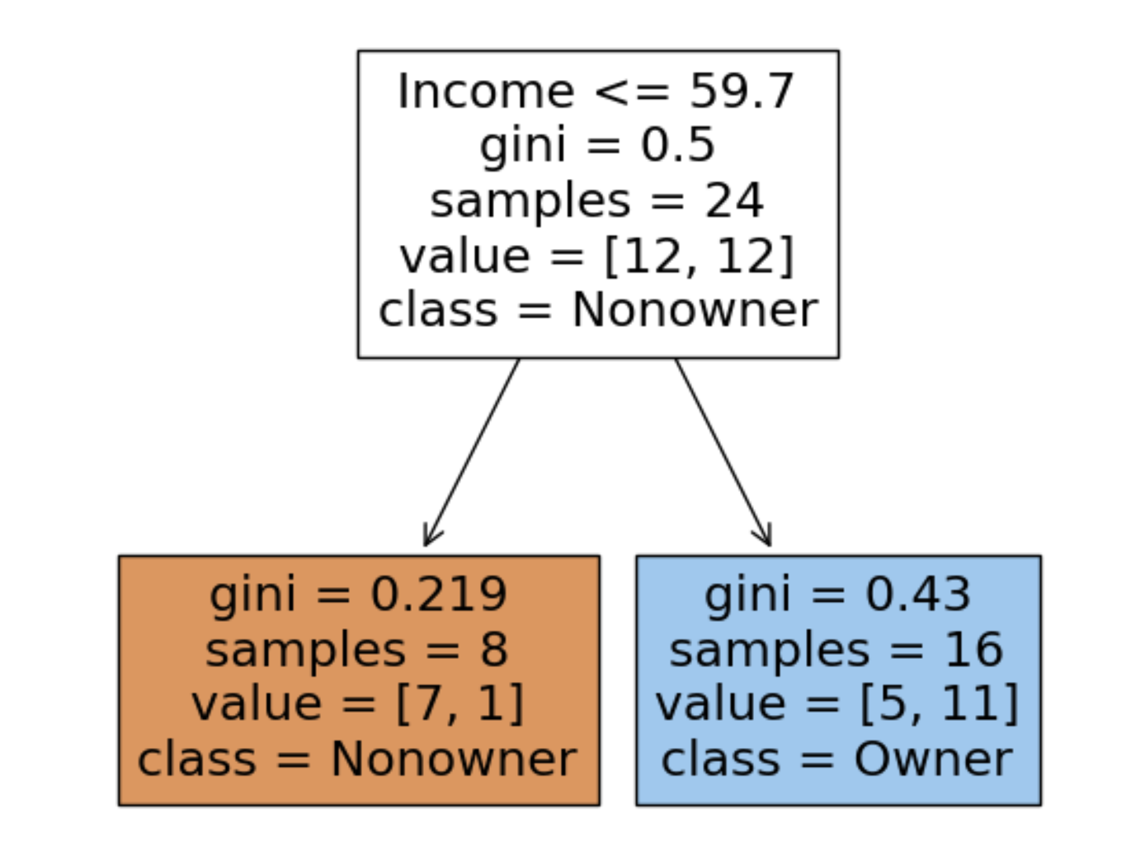
First Split – The Tree

Slide 25
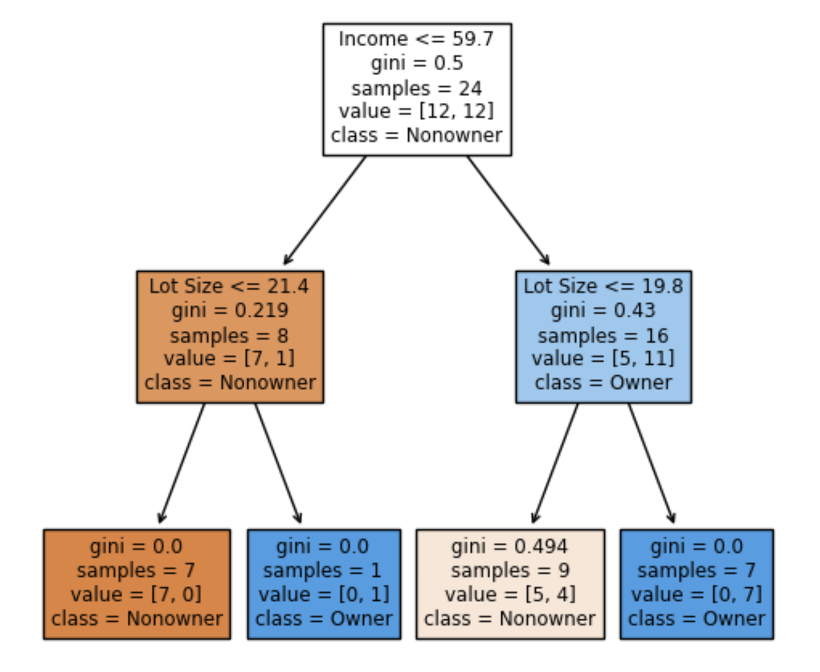
Tree After 3 Splits
The first split is on Income, then the next split is on Lot Size for both the low- income group (at lot size 21.4) and the high-income split (at lot size 19.8)

Slide 26
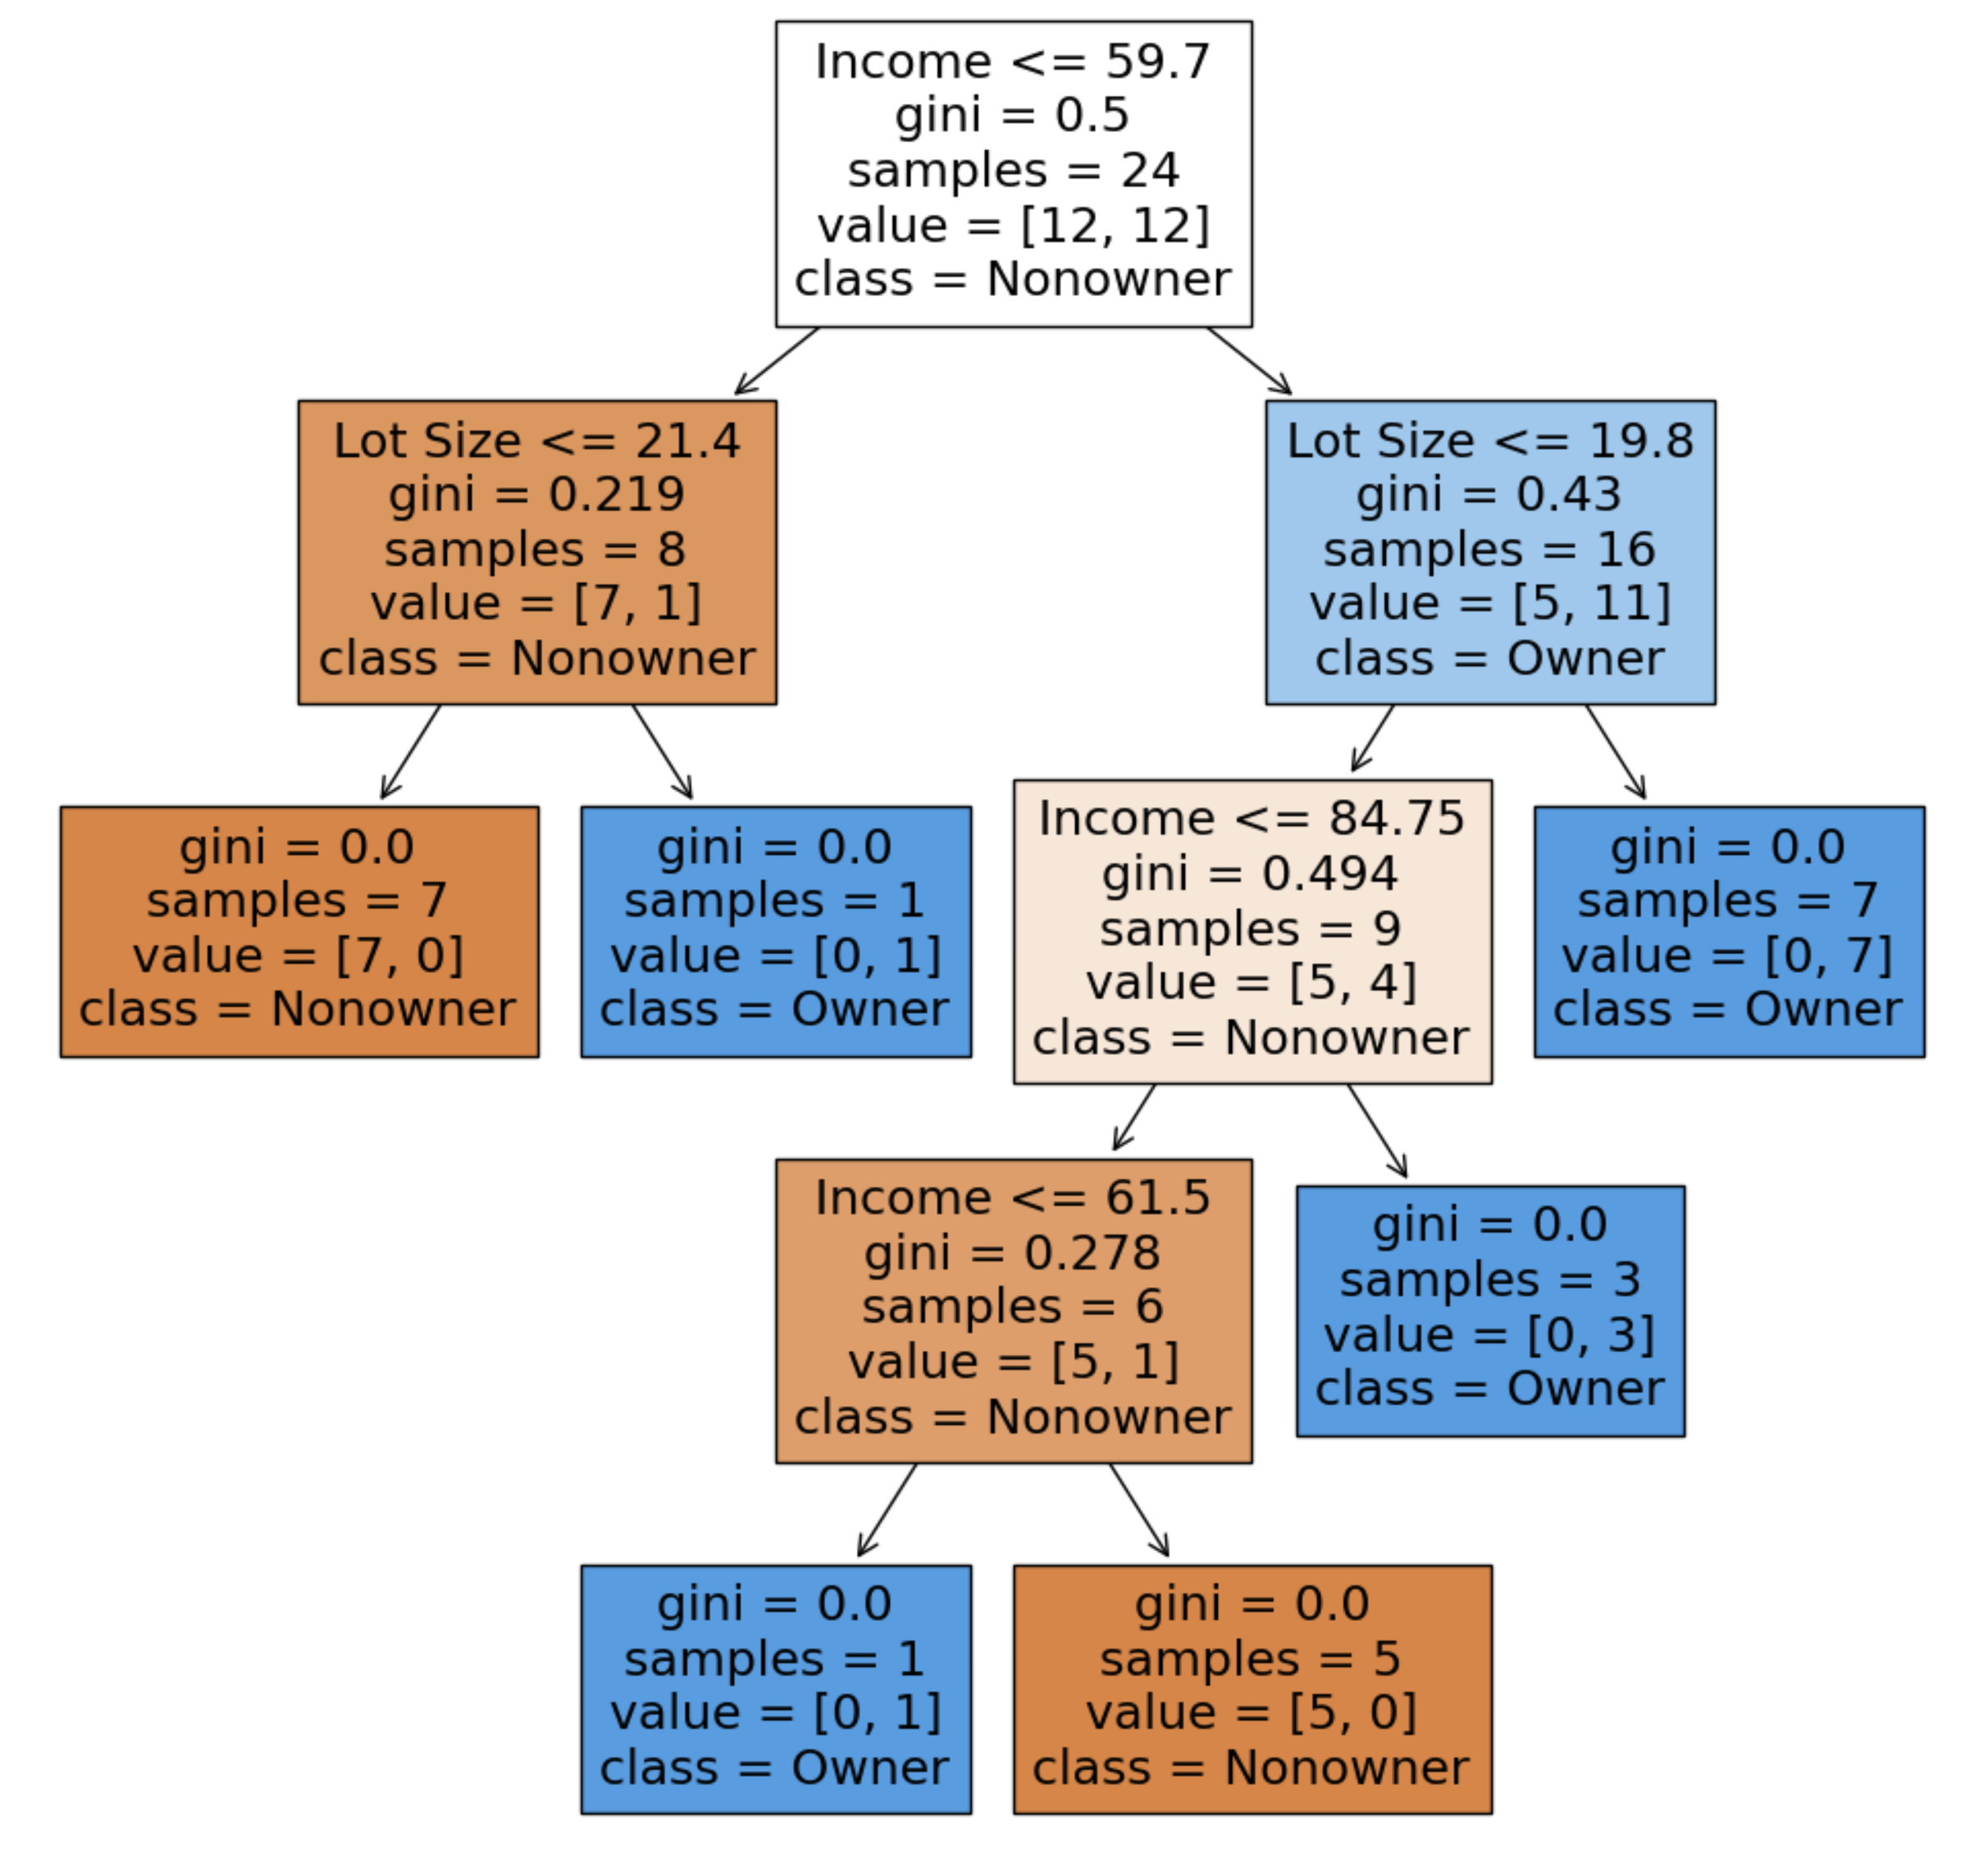
Tree After All Splits
Decision node
Terminal node (leaf)

Slide 27
The dominant class in this portion of the first split (those with income > 59.7) is “owner” 11 owners and 5 non-owners
The next split for this group of 16 will be on the basis of Income, splitting at 84.75

Slide 28
Read down the tree to derive rules
If Income <= 59.7 AND
Lot Size <= 21.4,
classify as “Nonowner”

Slide 29
Categorical Predictors
- Examine all possible ways in which the categories can be split.
- For example, categories A, B, C can be split 3 ways
{A} and {B, C}
{B} and {A, C}
{C} and {A, B}
- With many categories, # of splits becomes huge
- For categorical predictors, as with kNN, a predictor with m categories (m>2) should be factored into m dummies (not m-1)
- Do not standardize (normalize) categorical or numerical predictors

Slide 30
Evaluating the Performance
Training and Validation sets
Several predictors of roughly equal predictive power may lead to selection of different predictors for the top-level split depending on the sample
Yield completely different sets of rules
Results of a single tree may be problematic

Slide 31
Avoid Overfitting - Pruning the Tree

Slide 32
Full trees are complex and overfit the data
Natural end of process is 100% purity in each leaf.
Overfits the data, which end up fitting noise in the data.
Consider Example 2, Loan Acceptance with more records and more variables than the Riding Mower data – the full tree is very complex
bank_df = bank_df.drop(columns=['ID', 'ZIP Code'])
X = bank_df.drop(columns=['Personal Loan'])
y = bank_df['Personal Loan']
train_X, valid_X, train_y, valid_y = train_test_split(X, y, test_size=0.4, random_state=1)
fullClassTree = DecisionTreeClassifier(random_state=1) # default
fullClassTree.fit(train_X, train_y)
plotDecisionTree(fullClassTree, feature_names=train_X.columns)
Default is no restrictions on the maximum tree depth (or number of leaf nodes), or decrease in impurity

Slide 33
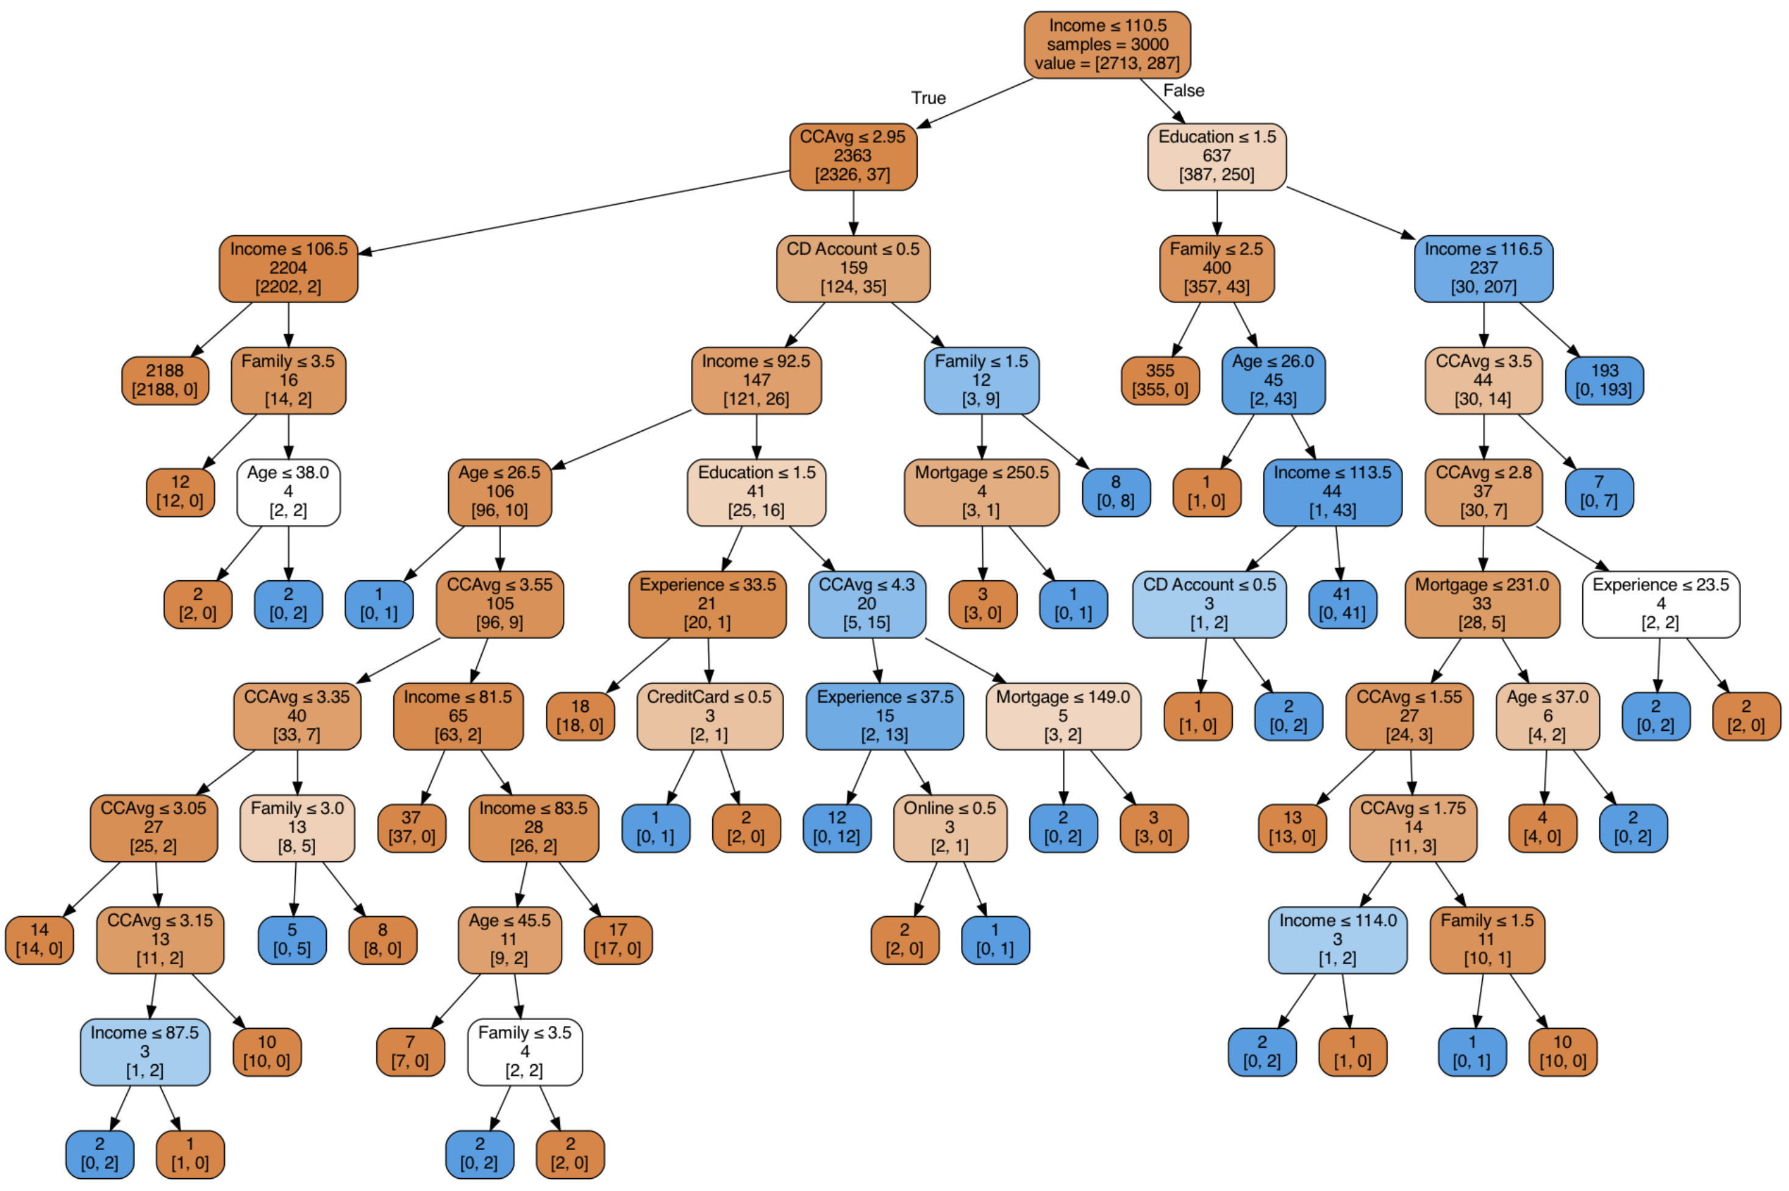
Full trees are too complex – they end up fitting noise, overfitting the data

Slide 34
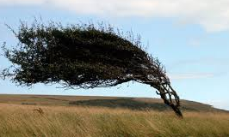

Trees can also be unstable
If 2 or more predictors are of roughly equal importance, which one CART chooses for the first split can depend on the initial partition into training and validation
A different partition into training/validation could lead to a different initial split
This can cascade down and produce a very different tree from the first training/validation partition
Solution is to try many different training/validation splits – “cross validation”

Slide 35
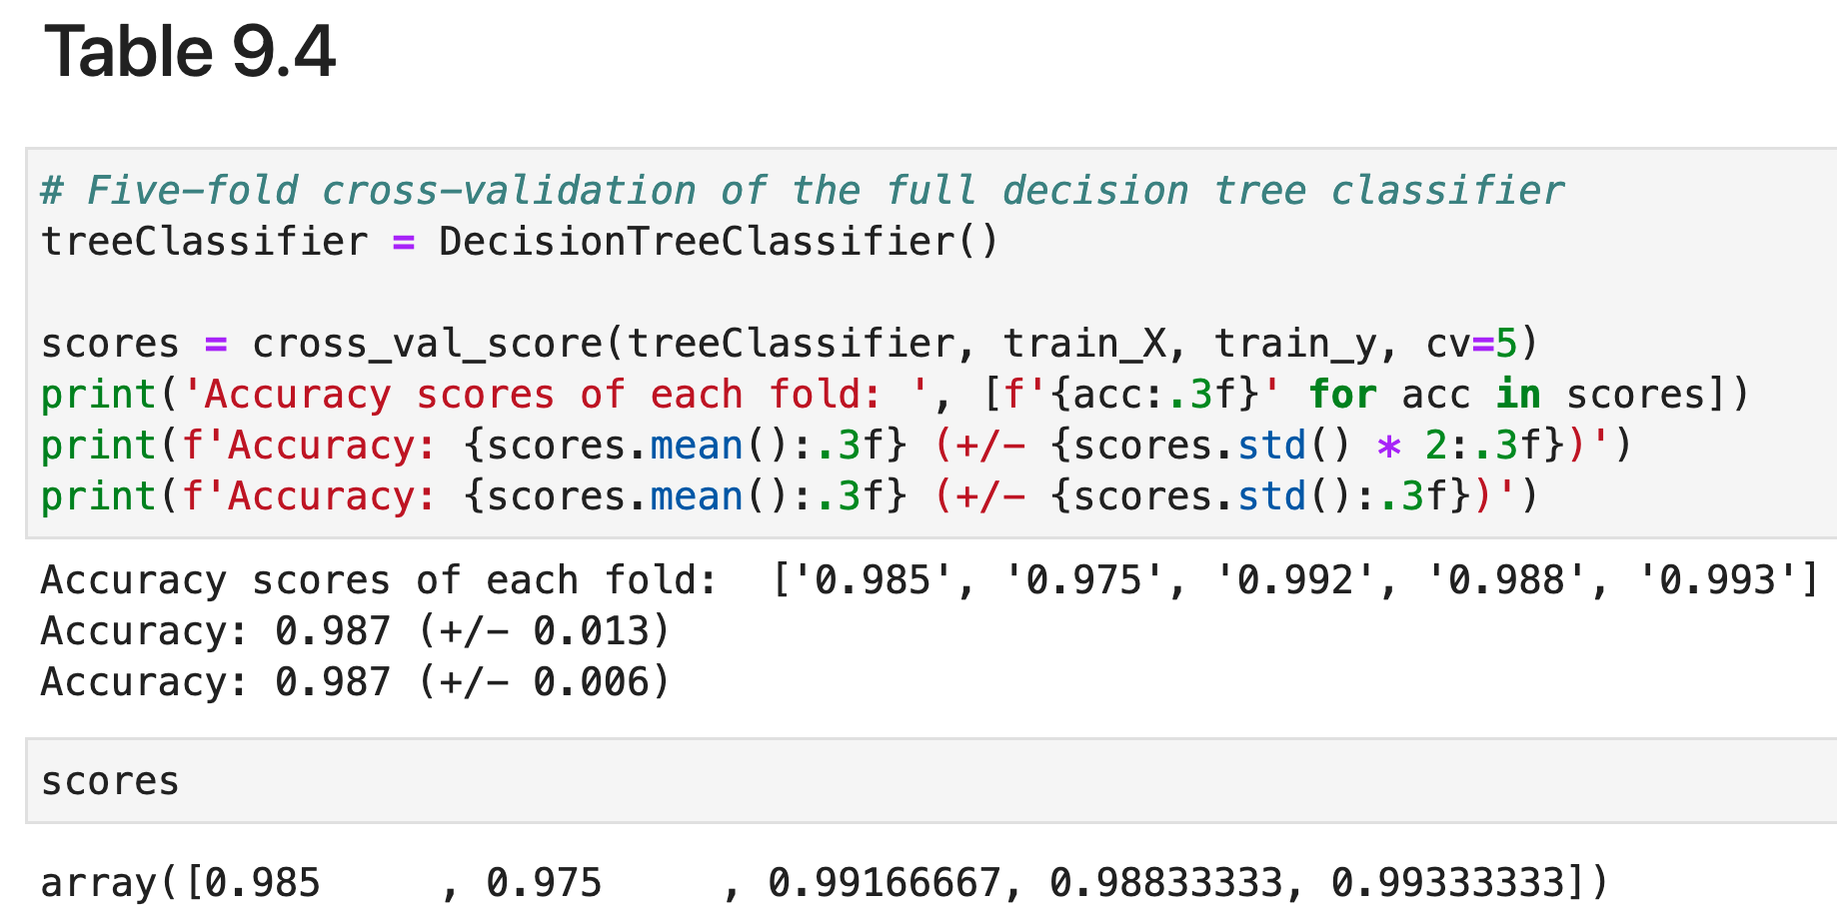
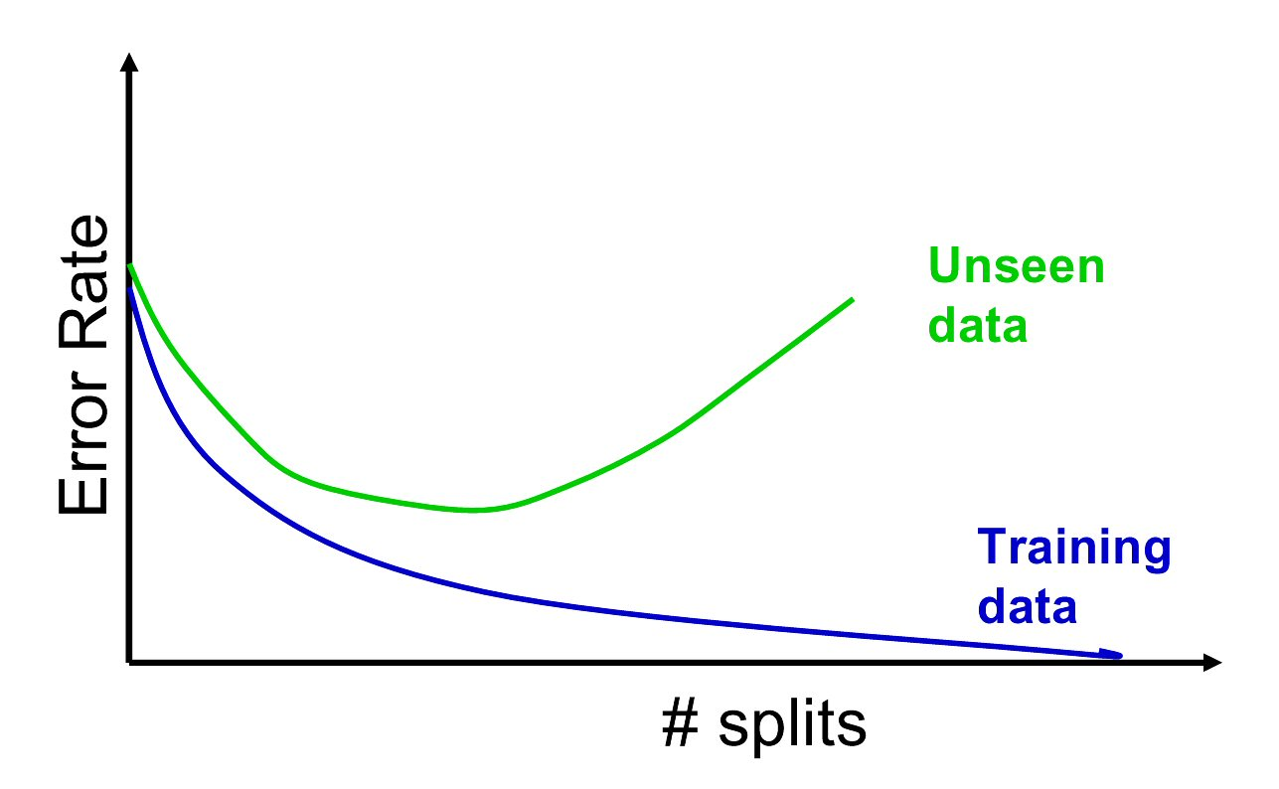
Overfitting & instability produce poor predictive performance – past a certain point in tree complexity, the error rate on new data starts to increase

Slide 36
Assessing Tree Performance
classificationSummary(train_y, FullClassTree.predict(train_X))
classificationSummary(valid_y, fullClassTree.predict(valid_X))
Output
# full tree: training
Confusion Matrix (Accuracy 1.0000)
Prediction
Actual 0 1
0 2713 0
1 0 287
# full tree: validation
Confusion Matrix (Accuracy 0.9790)
Prediction
Actual 0 1
0 1790 17
1 25 168

Slide 37
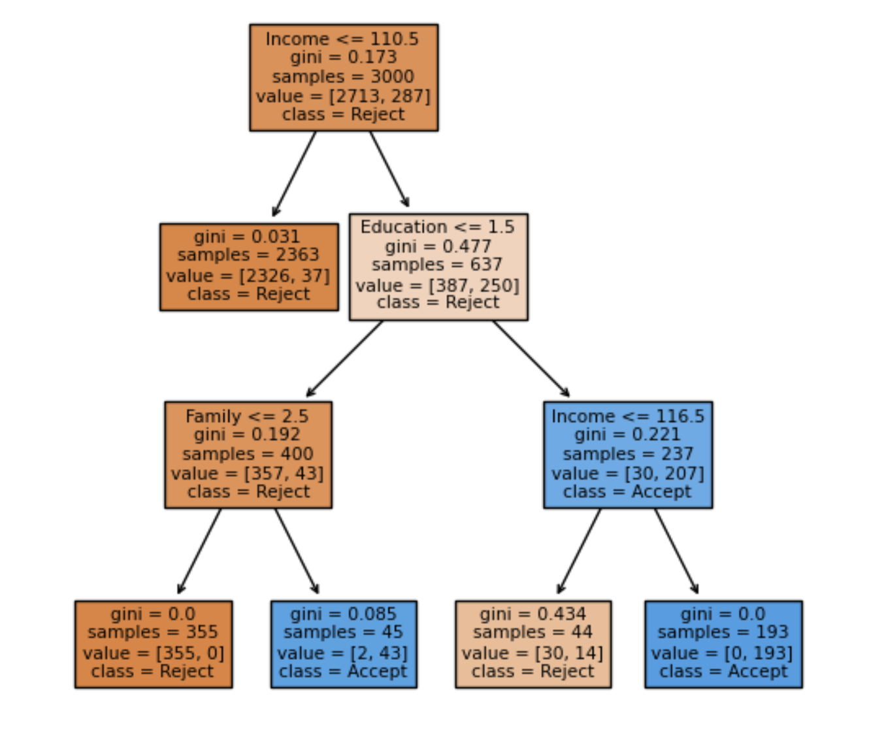
Limiting Tree Growth
In DecisionTreeClassifier() we can control
Tree depth
Minimum number of records in split nodes
Minimum number of records in terminal node
Minimum impurity decrease needed
smallClassTree = DecisionTreeClassifier(max_depth=30,
min_samples_leaf=20, min_impurity_decrease=0.01)
smallClassTree.fit(train_X, train_y)
Default values by the R function rpart()
But what are optimal values for these parameters, i.e., stopping rules?

Slide 38
Fine-tuning Tree Parameters via Grid Search
- Maximum depths in the range of [5, 30]
- Minimum number of records in terminal nodes between[20, 100]
- Impurity criterion decrease in the range [0.001, 0.01].
Use an exhaustive grid search to find the
combination that leads to the tree with smallest error
(highest accuracy).
However, using training set to tune and measure
accuracy will overfit training data and using validation
set to tune and measure accuracy will overfit
validation data.

Slide 39
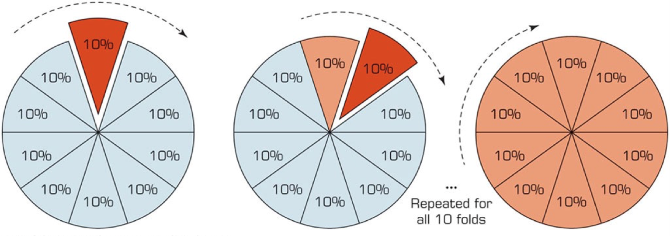
Fine-tuning Tree Parameter with Cross Validation (CV), test multiple trees
Partition training data into sets (folds) for model-fitting and evaluating
Fit model with training folds, and evaluate with holdout evaluation fold
Repeat, typically with holdout evaluation fold that is non-overlapping and smaller than training folds
For example, 10-fold CV fits 10 models, each evaluated on 10% of the data that is held out, with each set of evaluation data non-overlapping with the others.

Slide 40
Exhaustive GridsearchCV for Most Accurate Parameters
Use GridsearchCV on training data, coupled with Cross-Validation (CV)
Exhaustively build trees using different values for the parameters, using the training fold (of training data)
Measure accuracy on the holdout evaluation fold (of training data)
Choose tree with best performance
Assess its performance on the validation data, not used at all to this point.

Slide 41
RandomizedSearchCV() - alternative to exhaustive search
GridSearchCV() can be prohibitively time-consuming if many parameters are involved.
RandomizedSearchCV() randomly sample all possible combinations while limiting the number of iterations through the parameter n_iter (set to the number of permitted iterations)

Slide 42
GridSearchCV()code
# Start with an initial guess for parameters
param_grid = {
'max_depth': [10, 20, 30, 40],
'min_samples_split': [20, 40, 60, 80, 100],
'min_impurity_decrease': [0, 0.0005, 0.001, 0.005, 0.01],
}
# Which values are best?
# n_jobs=-1 will utilize all available CPUs
gridSearch = GridSearchCV(DecisionTreeClassifier(random_state=1),
param_grid, cv=5, n_jobs=-1)
gridSearch.fit(train_X, train_y)
print('Initial score: ', gridSearch.best_score_)
print('Initial parameters: ', gridSearch.best_params_)

Slide 43
GridSearchCV()code - refined
# Adapt grid based on result from initial grid search
param_grid = {
'max_depth': list(range(2, 16)), # 14 values
'min_samples_split': list(range(15, 25)), # 11 values
'min_impurity_decrease': [0.0004, 0.0005, 0.0006], # 3 values
}
gridSearch = GridSearchCV(DecisionTreeClassifier(random_state=1),
param_grid, cv=5, n_jobs=-1)
gridSearch.fit(train_X, train_y)
print('Improved score: ', gridSearch.best_score_)
print('Improved parameters: ', gridSearch.best_params_)
bestClassTree = gridSearch.best_estimator_

Slide 44
Performance
# Results from initial guess at parameters
Initial score: 0.988
Initial parameters: {'max_depth': 10, 'min_impurity_decrease': 0.0005,
'min_samples_split': 20}
# Results after second Gridsearch
Improved score: 0.9883333333333333
Improved parameters: {'max_depth': 5, 'min_impurity_decrease': 0.0004,
'min_samples_split': 20}

Slide 45
GridSearchCV()results
# Recall original full tree
# full tree: validation
Confusion Matrix (Accuracy 0.9790)
Prediction
Actual 0 1
0 1790 17
1 25 168
# Results after Gridsearch
# full tree: validation
Confusion Matrix (Accuracy 0.9825)
Prediction
Actual 0 1
0 1793 14
1 21 172

Slide 46
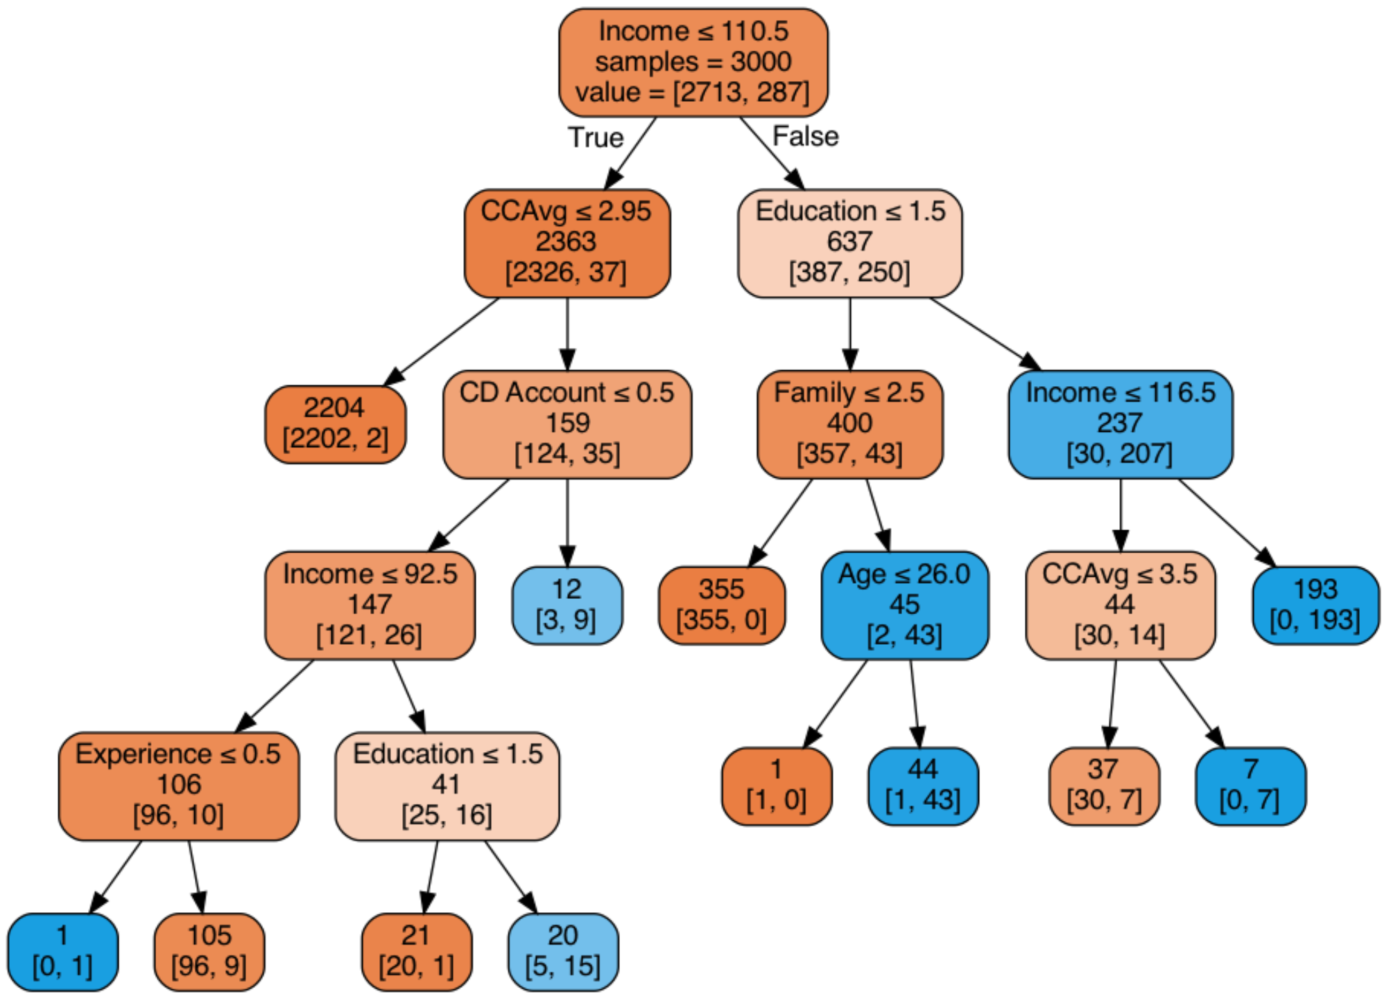
Resulting Tree

Slide 47
Other Methods for Limiting Tree Size
CHAID
Pruning - CART method (Breiman et al.)

Slide 48
CHAID Chi-squared Automatic Interaction Detection
Analyze the relationship between a set of predictors (independent variables) and a categorical outcome variable.
Builds non-binary decision trees (nodes can have more than two branches).
A key feature of CHAID is its ability to perform multi-way splits. Instead of only two branches (like in a binary tree), a single node can split into three, four, or more branches corresponding to the categories of the chosen predictor variable.

Slide 49
CHAID Chi-squared Automatic Interaction Detection
At each node, CHAID selects the predictor variable that has the strongest association with the target variable, measured using the Chi-squared test statistic.
For Nominal Predictors: The variable with the lowest p-value (indicating the strongest relationship) is chosen.
For Continuous Predictors: Continuous variables are first grouped into categories (discretized), and then the Chi-squared test is applied to the groupings.

Slide 50
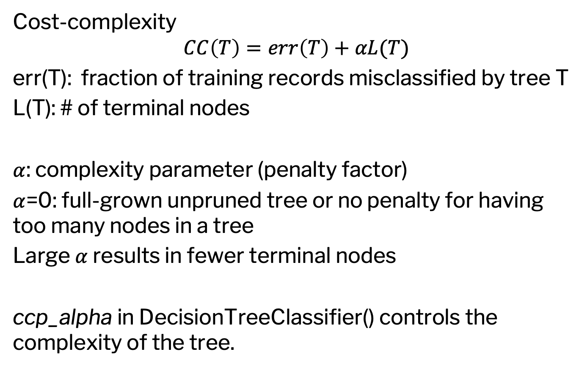
CART Method
Cost-complexity
$$CC\left(T\right)=err\left(T\right)+αL(T)$$
err(T): fraction of training records misclassified by tree T
L(T): # of terminal nodes
$α$: complexity parameter (penalty factor)
$α$=0: full-grown unpruned tree or no penalty for having too many nodes in a tree
Large $α$ results in fewer terminal nodes
ccp_alpha in DecisionTreeClassifier() controls the complexity of the tree.

Slide 51
Regression Trees

Slide 52
Regression Tree is Similar, Except...
Prediction is computed as the average of numerical target variable in the rectangle (in CT it is majority vote)
Impurity measured by sum of squared deviations from leaf mean
Performance measured by RMSE (Root Mean Squared Error)
See Example code in Table 9.7

Slide 53
Ensemble
A single tree has the transparency advantage, i.e., visualization.
Visualizing a set of rules does not matter in a pure prediction application
Several extensions to trees that combine results
from multiple trees provide better performance in prediction
An ensemble method combines many simple "building block" models to obtain a single and potentially powerful model

Slide 54
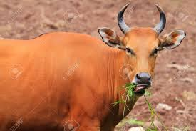
The Ox Contest “The Wisdom of Crowds”
Ensemble of methods often predicts more
accurately
Francis Galton, famous statistician, saw a county fair contest to judge the weight of an ox.
Individual guesses were all over the map, but the average of them all was within 1% of the ox’s true weight.
The Wisdom of Crowds,
by James Surowiecki
Notes:
54

Slide 55
Ensemble Methods for Classification and Prediction
In an ensemble approach, multiple methods are used initially, and predictions/classifications tabulated
- Predicting a numeric value? Take the average of the values predicted by the various methods
- Predicting a class? Take a majority vote of the classes predicted by the various methods
- Predicting a propensity (probability of “success” or belonging to the class of interest)? Take the average of the propensities
Notes:
55

Slide 56
Why Ensembles Can Improve Predictive Power?
The key is reducing the variance in predictions
- Individual methods will produce predictions that have errors, some positive and some negative
- "Risk" is equivalent to variation in prediction error
- The principle of combining methods is for reducing risk
- If prediction methods are unbiased, on balance, errors tend to cancel each other out
- An average of multiple predictions takes advantage of this canceling out and, most of the time, is more accurate than individual predictions.

Slide 57
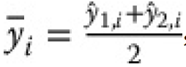
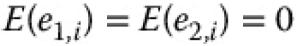
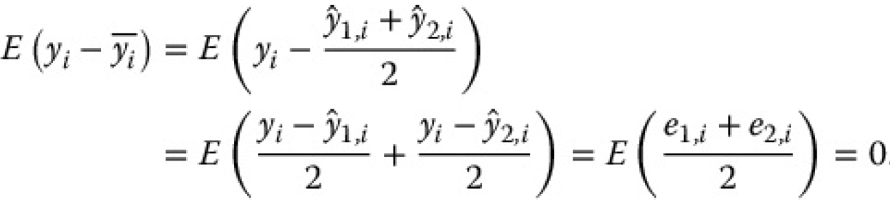
Why Ensembles Can Improve Predictive Power?

Slide 58
Popular forms of ensembles
Bagging
Random Forest
Boosting
Bayesian Additive Regression Trees
Most often applied to trees

Slide 59

Bagging (Bootstrap aggregating)
The “multiplier” effect in bagging comes from multiple bootstrap samples, rather than multiple methods. Bootstrapping is to take resamples, with replacement, from the original data.
Generate multiple bootstrap resamples
Run algorithm on each and produce scores
Average those scores (or take majority vote)
Random forest is a special case of bagging.

Slide 60
Random Forest
Draw multiple random samples, with replacement, from data (“bootstrap resampling”)
Fit tree to each resample using a random set of predictors
Combine the classifications/predictions from all the resampled trees (the “forest”) to obtain improved predictions
Basic idea: taking an average of multiple estimates (models) is more reliable than just using a single estimate

Slide 61
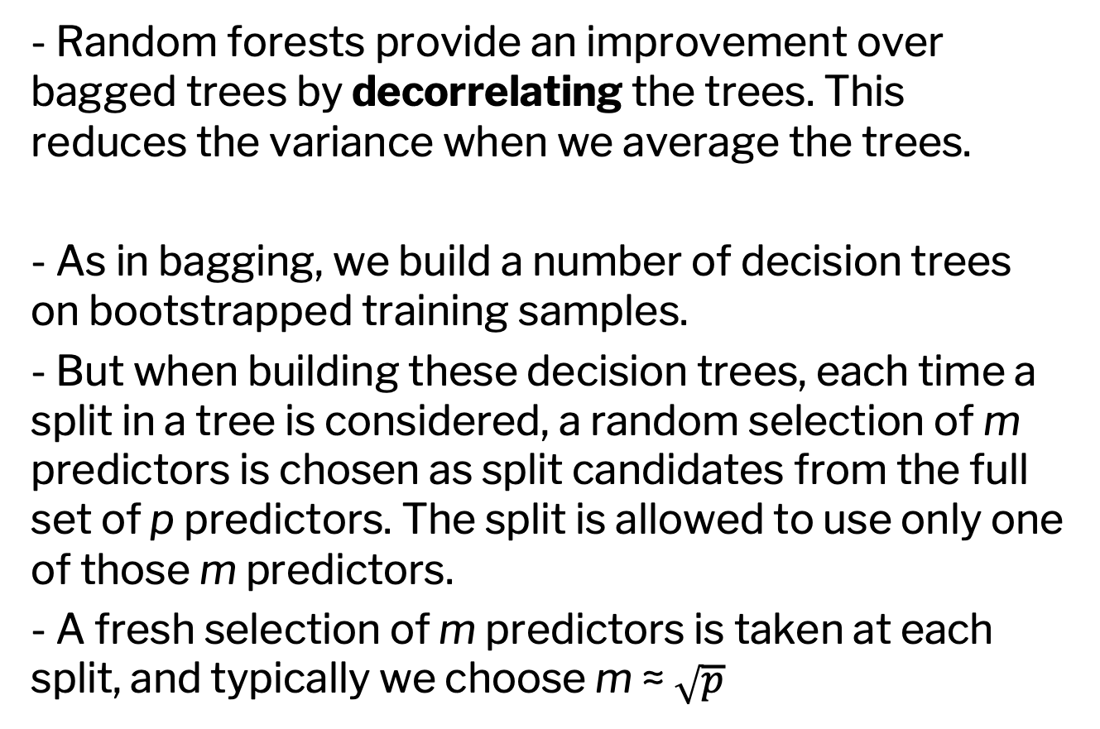
Random Forest
- Random forests provide an improvement over bagged trees by decorrelating the trees. This reduces the variance when we average the trees.
- As in bagging, we build a number of decision trees on bootstrapped training samples.
- But when building these decision trees, each time a split in a tree is considered, a random selection of m predictors is chosen as split candidates from the full set of p predictors. The split is allowed to use only one of those m predictors.
- A fresh selection of m predictors is taken at each split, and typically we choose m ≈ $\sqrt{p}$

Slide 62
Random Forest
bank_df = pd.read_csv('UniversalBank.csv')
bank_df.drop(columns=['ID', 'ZIP Code'], inplace=True)
X = bank_df.drop(columns=['Personal Loan'])
y = bank_df['Personal Loan']
train_X, valid_X, train_y, valid_y = train_test_split(X, y,
test_size=0.4, random_state=1)
rf = RandomForestClassifier(n_estimators=500,
random_state=1)
rf.fit(train_X, train_y)

Slide 63
Variable Importance
Each variable is used by some trees and not others
We can, therefore, measure each variable’s contribution to reducing impurity (reduction in Gini Index)
This is the variable importance score

Slide 64
Variable Importance, code
# variable (feature) importance plot
importances = rf.feature_importances_
std = np.std([tree.feature_importances_ for tree in
rf.estimators_], axis=0)
df = pd.DataFrame({'feature': train_X.columns,
'importance': importances, 'std': std})
df = df.sort_values('importance')
print(df)
ax = df.plot(kind='barh', xerr='std', x='feature',
legend=False)
ax.set_ylabel('')
plt.show()

Slide 65
Variable Importance scores
and their variability across trees
Output
feature importance std
7 Securities Account 0.003964 0.004998
9 Online 0.006394 0.005350
10 CreditCard 0.007678 0.007053
6 Mortgage 0.034243 0.023469
1 Experience 0.035539 0.016061
0 Age 0.036258 0.015858
8 CD Account 0.057917 0.043185
3 Family 0.111375 0.053146
4 CCAvg 0.172105 0.103011
5 Education 0.200772 0.101002
2 Income 0.333756 0.129227

Slide 66
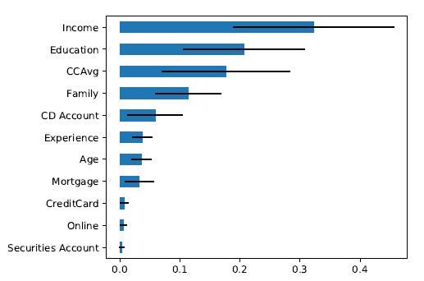
Variable Importance Plot

Slide 67
Boosting
1. Adaptive Boosting
2. Gradient Boosting
2. XGBoost

Slide 68
Adaptive Boosting (AdaBoost)
Fits a succession of single trees
Each successive fit up-weights the misclassified records from prior stage
You now have a set of classifications or predictions, one from each tree
Use weighted voting for classification, weighted average for prediction, higher weights to later trees

Slide 69
Adaptive Boosting (AdaBoost)
Especially useful for the “rare case” scenario (suppose 1’s are the rare class)
With simple classifiers, it can be hard for a “1” to “break out” from the dominant classification, & many get misclassified
Up-weighting them focuses the tree fitting on the 1’s, and reduces the dominating effect of the 0’s

Slide 70
Adaptive Boosting (AdaBoost)
1. Fit a single tree
2. Draw a sample that gives higher selection probabilities to misclassified records
3. Fit a tree to the new sample
4. Repeat Steps 2 and 3 multiple times
5. Use weighted voting to classify records, with heavier weight for later trees

Slide 71
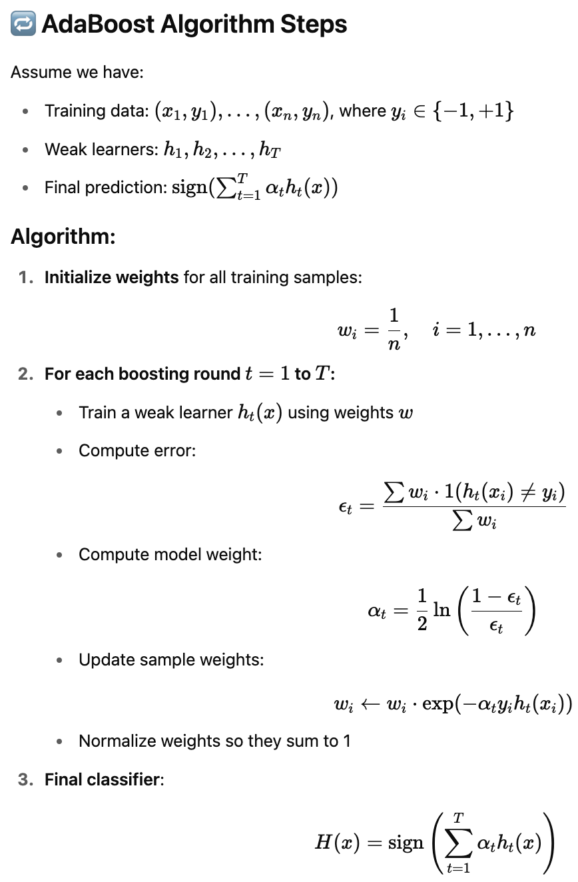
Adaptive Boosting (AdaBoost)

Slide 72
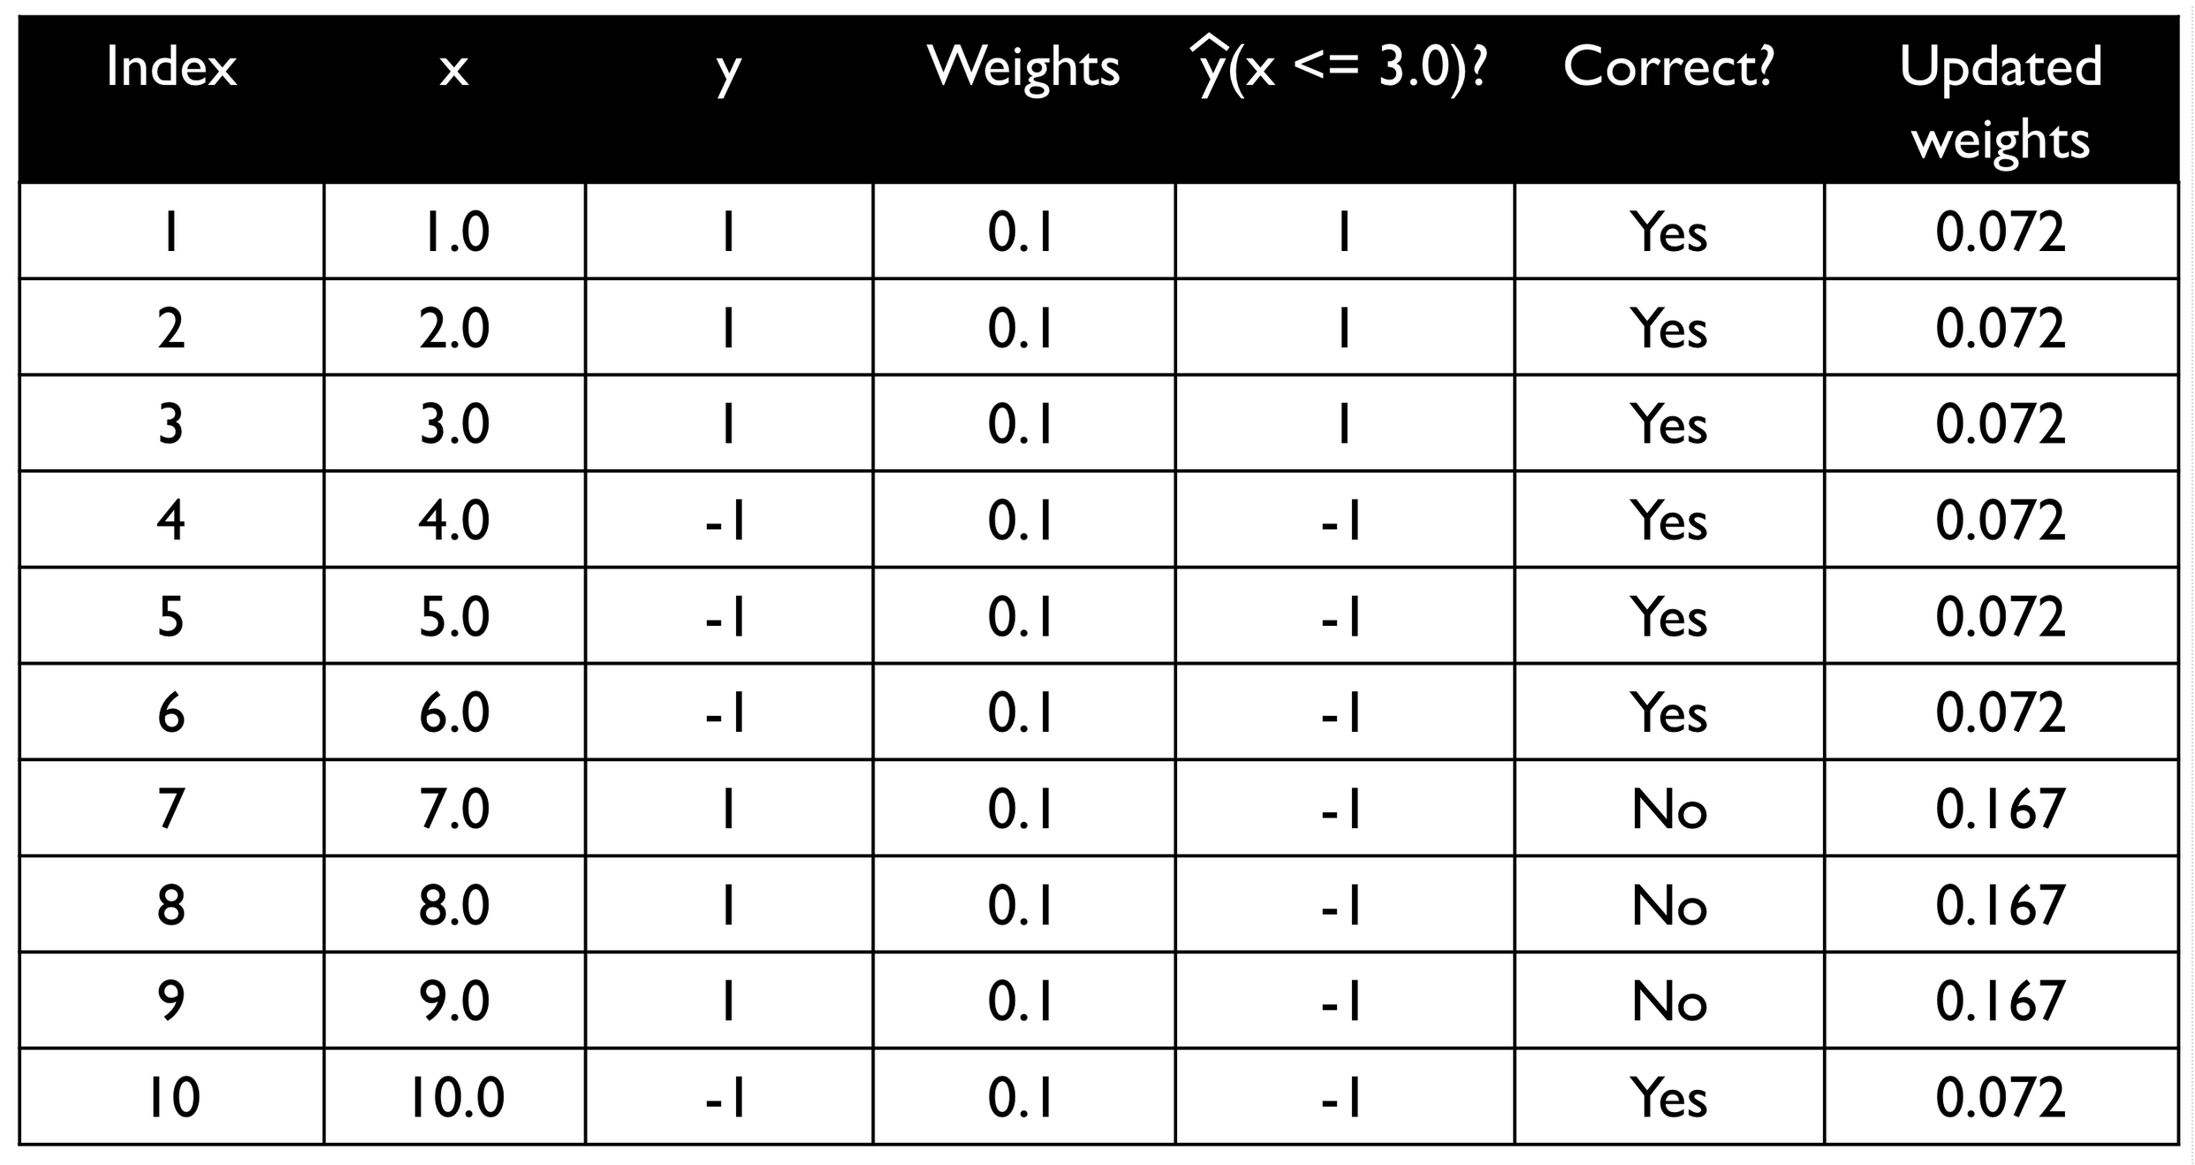
Adaptive Boosting (AdaBoost) Example

Slide 73
Gradient Boosting
Similar to AdaBoost
Fit decision trees iteratively using prediction errors
Deeper than decision tree stumps (maximum depth of 3 to 6 or a maximum number of 8 to 64 leaf nodes)
Use prediction error as a target to fit the next tree
Use a global learning rate
At each iteration, the tree ensemble improves by nudging each tree more in the right direction via small updates based on a loss gradient
For binary classification, use the logistic loss function
-y_{i}log(p_{i}) - (1-y_{i})log(1-p_{i})
Rewrite the logistic loss function in terms of log(odds) and simplify the derivative of this logistic loss function to (y_{i}-p_{i}) where y_{i} is 0 or 1

Slide 74
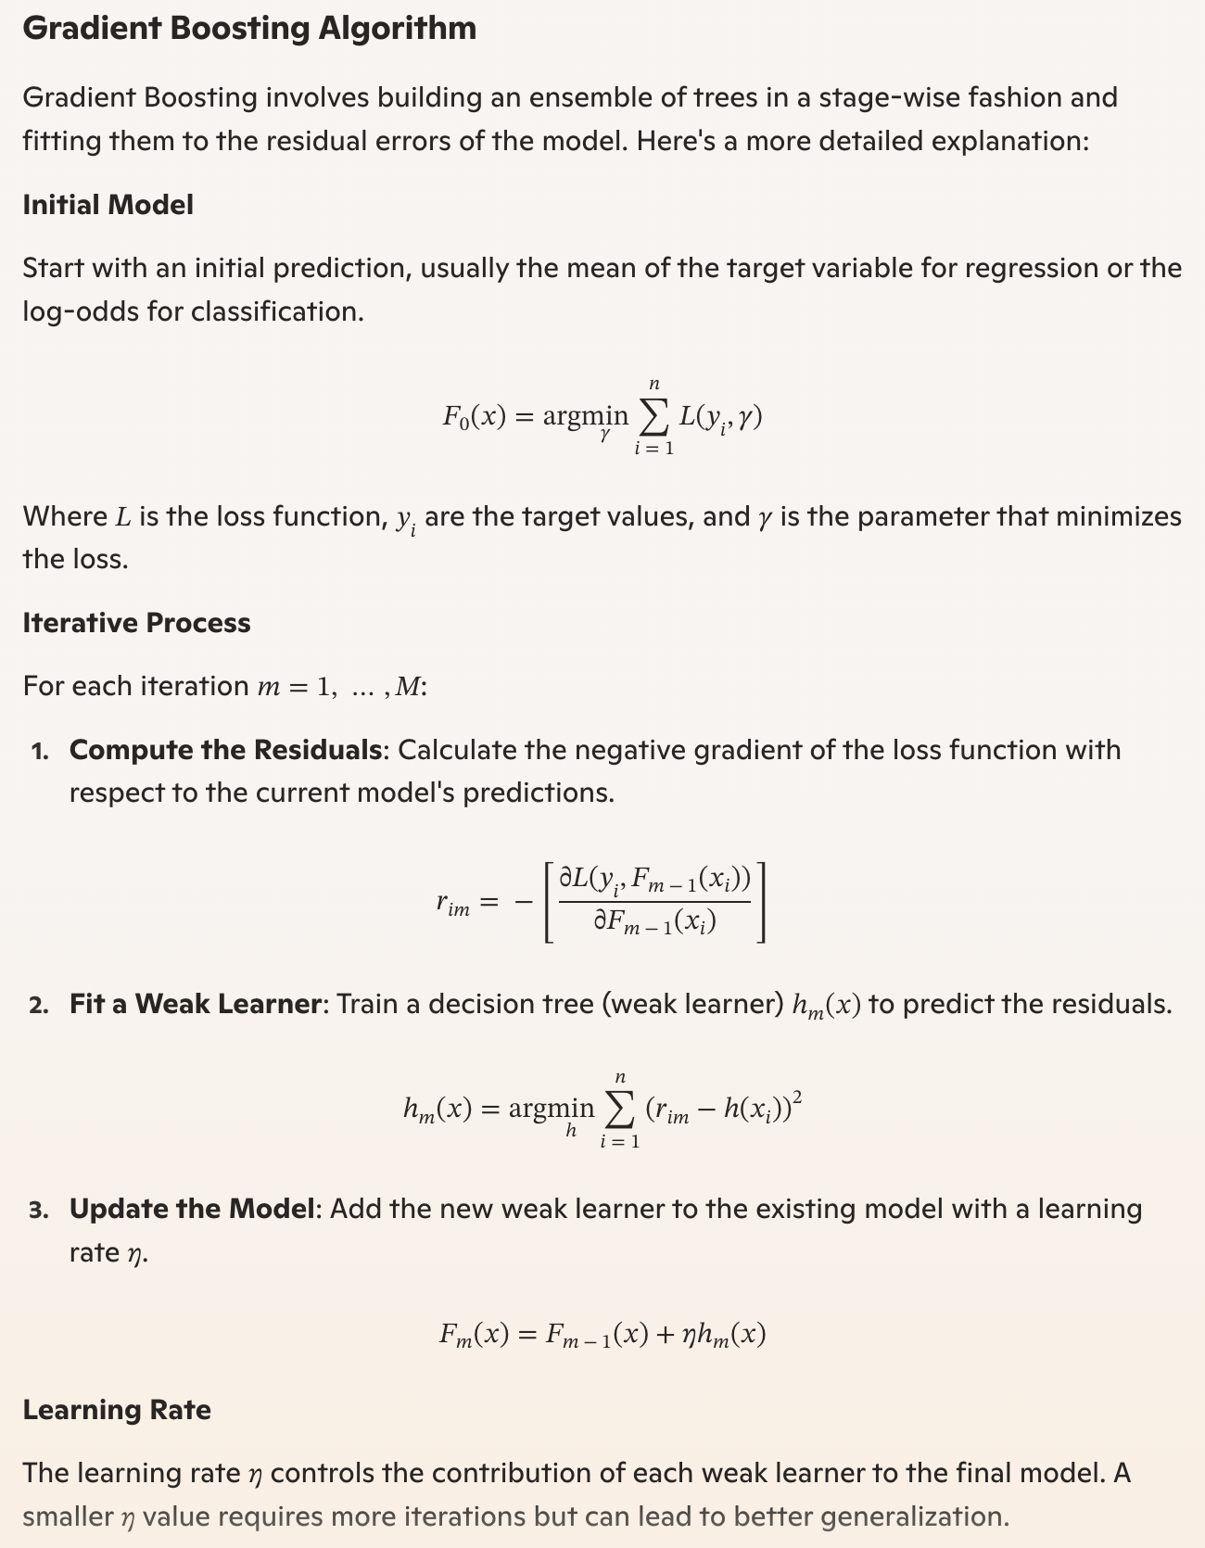
Gradient Boosting Algorithm

Slide 75
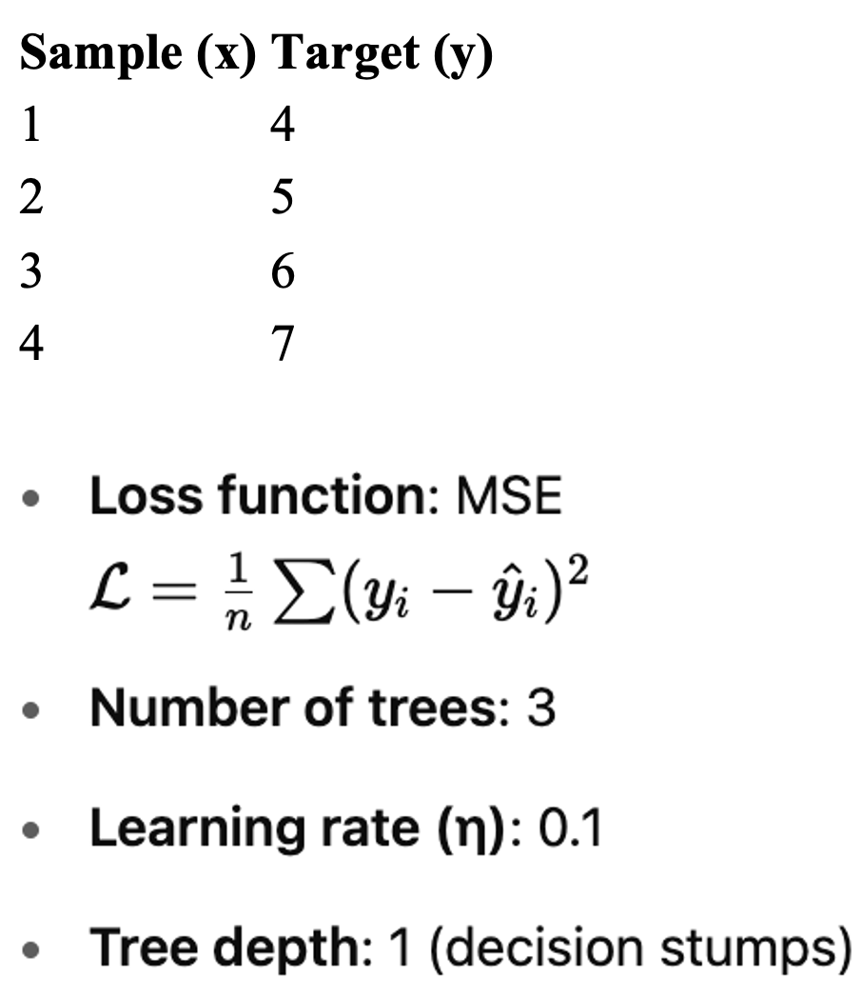
Gradient Boosting Illustration - Regression Tree
Use gradient boosting to fit a regression model for a very small dataset, minimizing Mean Squared Error (MSE).

Slide 76
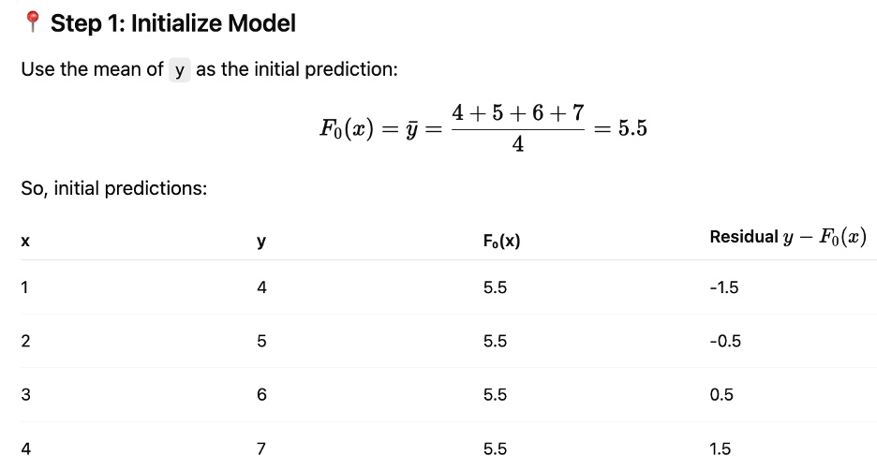
Gradient Boosting Illustration - Regression Tree

Slide 77
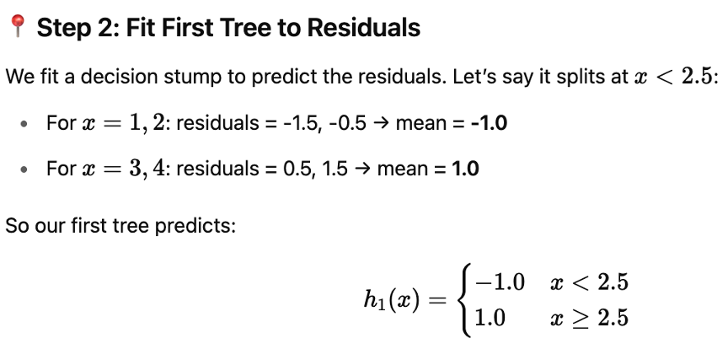
Gradient Boosting Illustration - Regression Tree

Slide 78
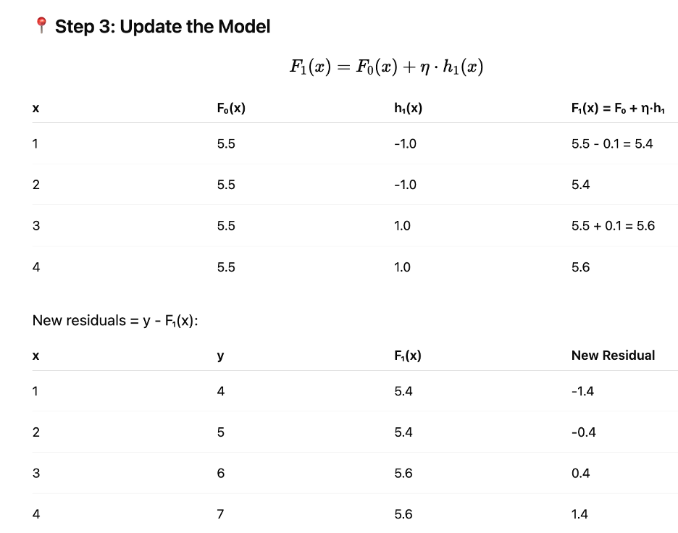
Gradient Boosting Illustration – Regression Tree

Slide 79
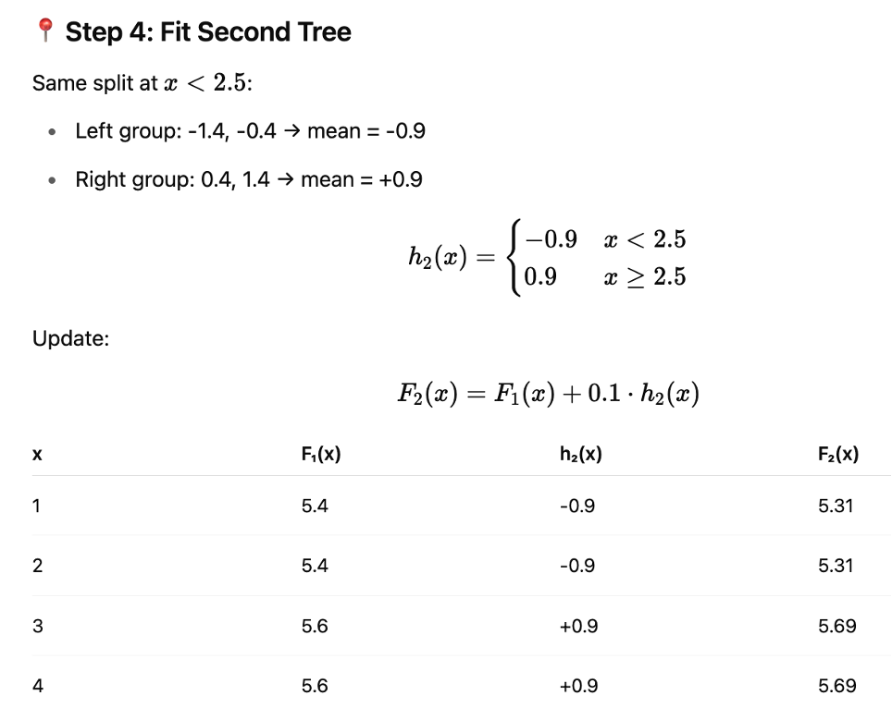
Gradient Boosting Illustration – Regression Tree

Slide 80
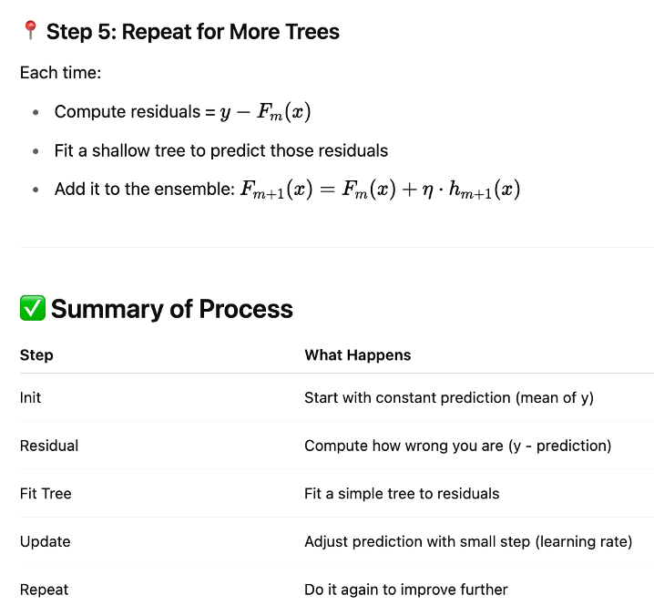
Gradient Boosting Illustration – Regression Tree

Slide 81
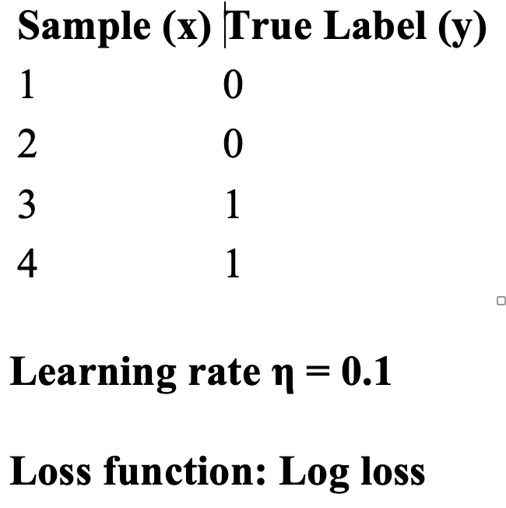
Gradient Boosting Illustration - Classification Tree

Slide 82
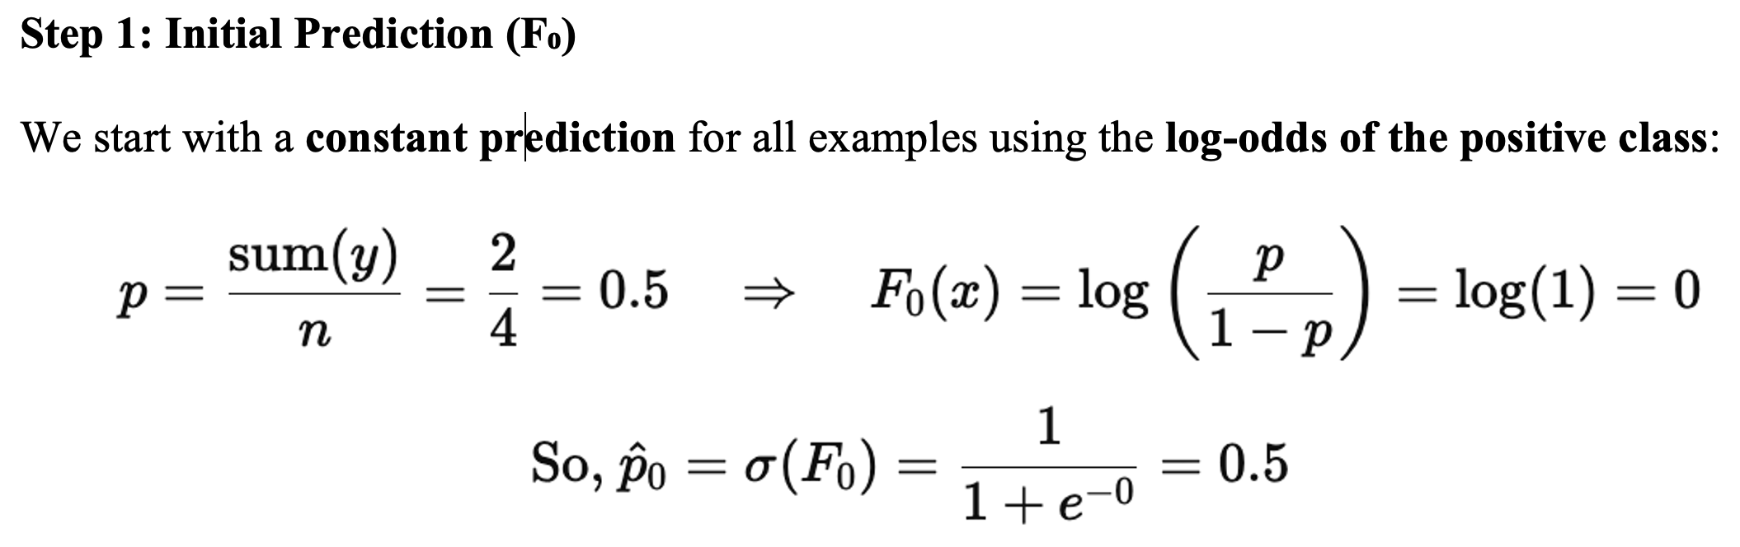
Gradient Boosting Illustration - Classification Tree

Slide 83
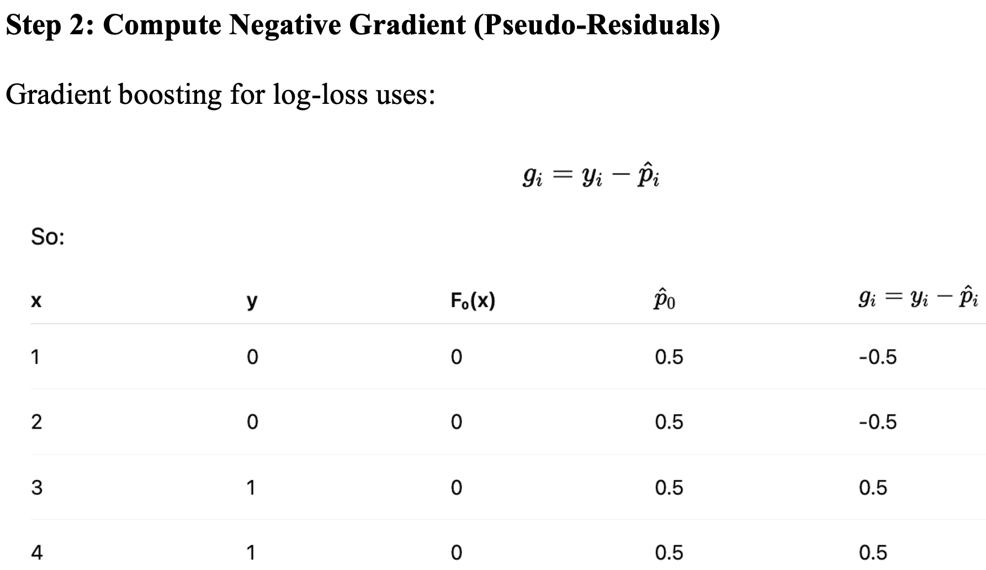
Gradient Boosting Illustration - Classification Tree

Slide 84
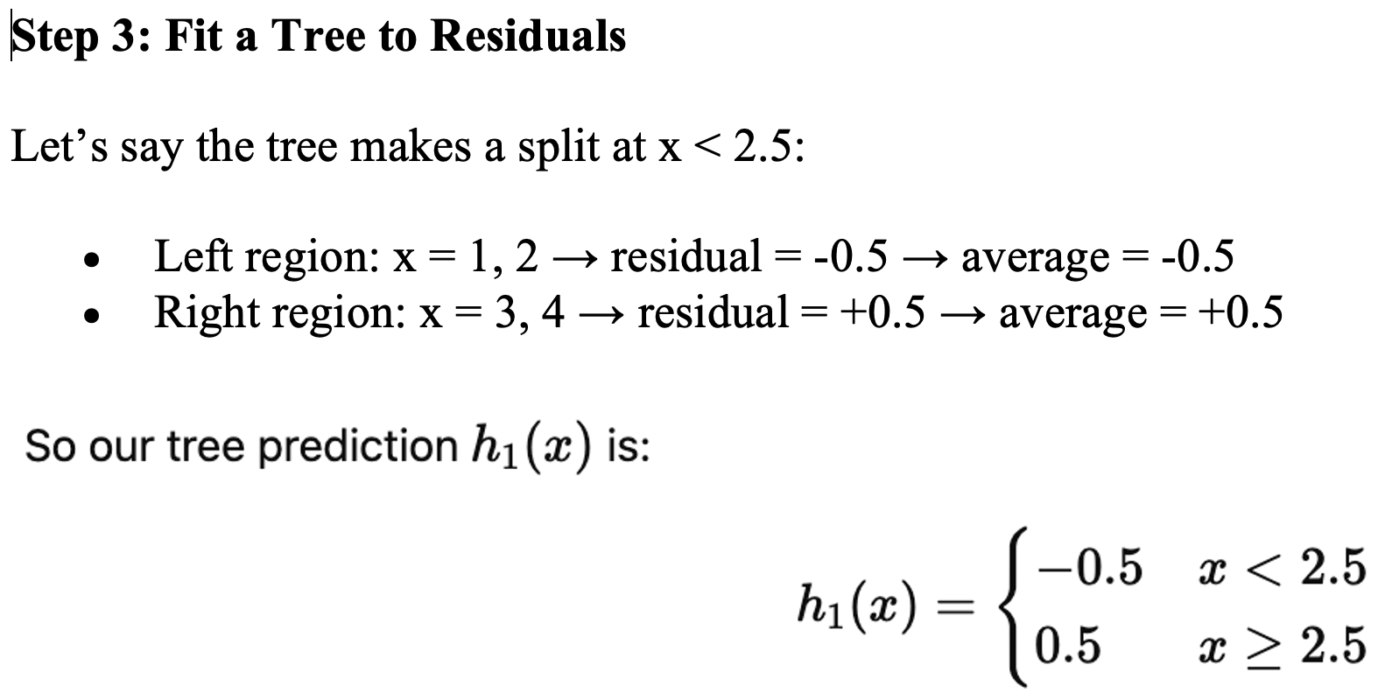
Gradient Boosting Illustration - Classification Tree

Slide 85
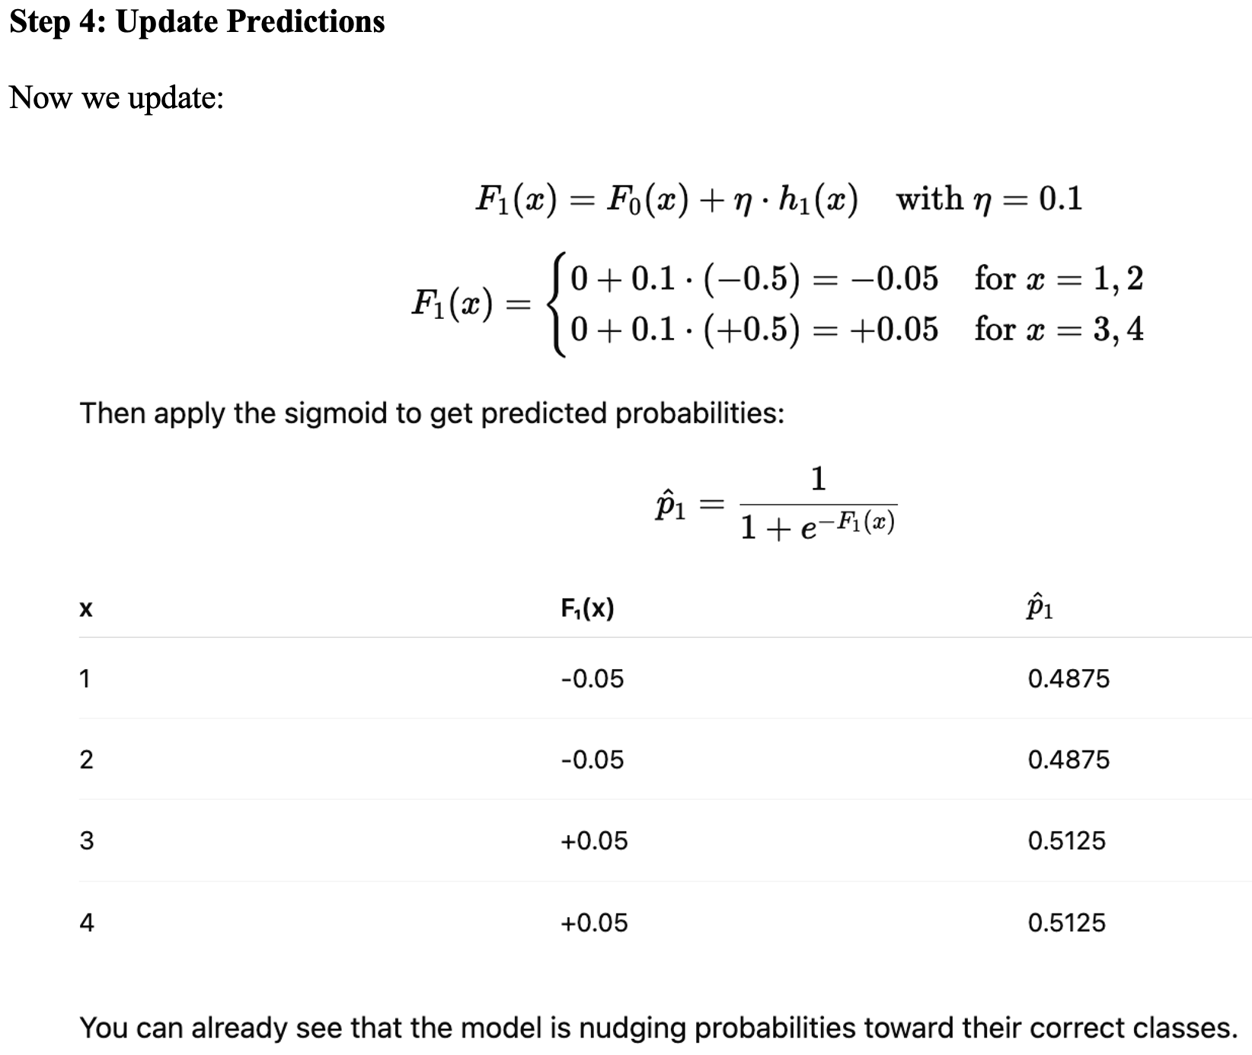
Gradient Boosting Illustration - Classification Tree

Slide 86
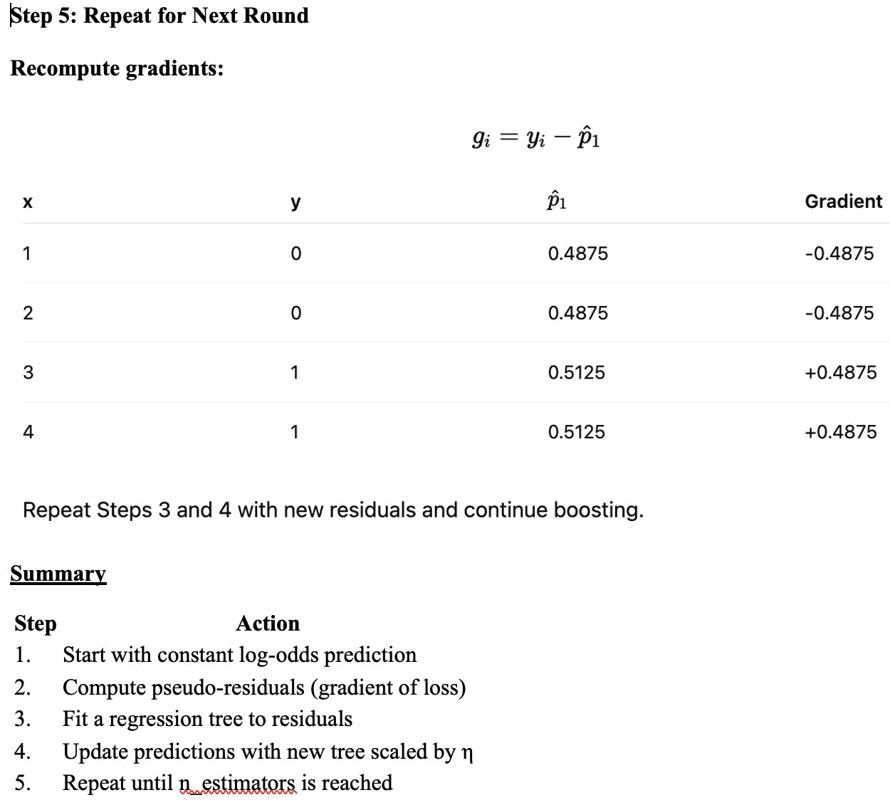
Gradient Boosting Illustration - Classification Tree

Slide 87
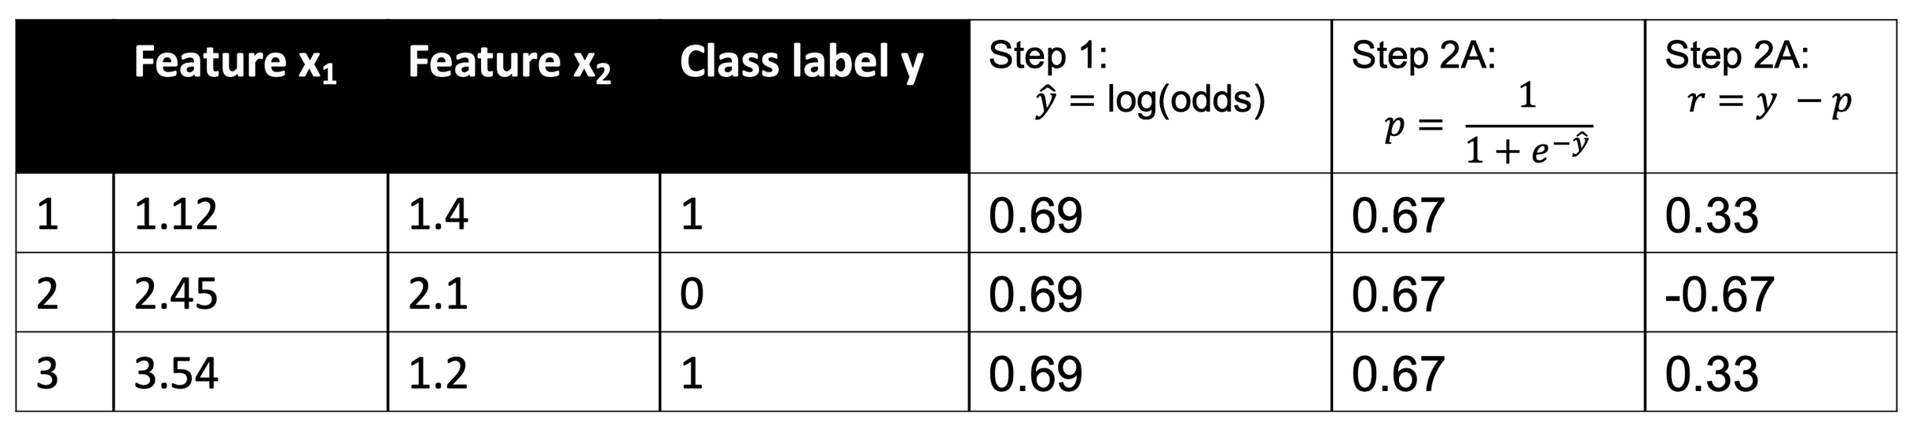
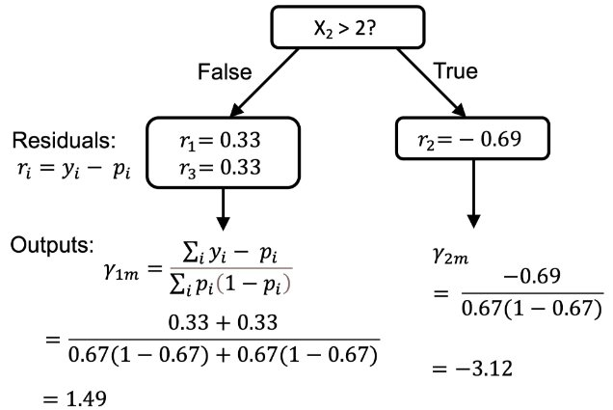
Gradient Boosting Algorithm - Illustration

Slide 88
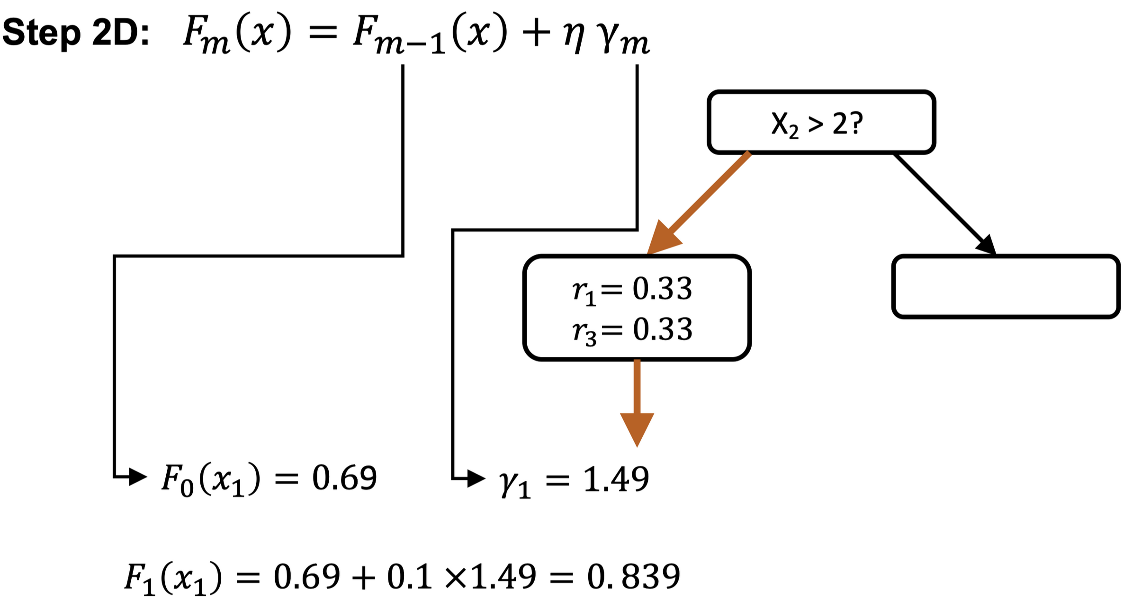
Gradient Boosting Algorithm - Illustration

Slide 89
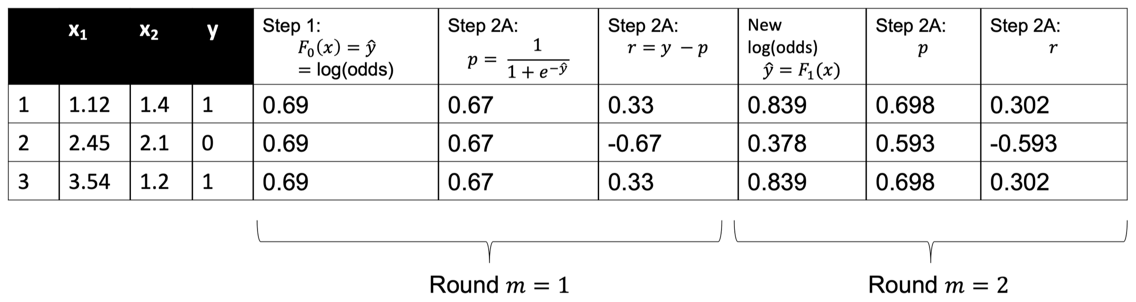
Gradient Boosting Algorithm - Illustration

Slide 90
XGBoost
XGBoost (eXtreme Gradient Boosting ) builds upon this vanilla gradient boosting algorithm but introduces a series of key enhancements that make it faster, more regularized, and more accurate in many real-world tasks.
Open-source software library which provides a regularizing gradient boosting framework for C++, Java, Python, R, Julia, Perl, and Scala.
XGBoost gained much popularity and attention in the mid-2010s as the algorithm of choice for many winning teams of machine learning competitions.

Slide 91
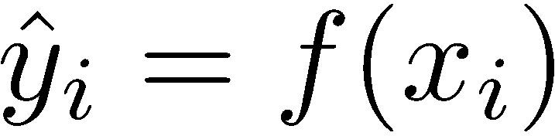
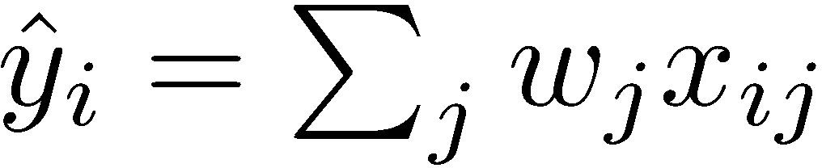
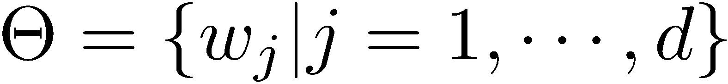



Elements of Supervised Learning
Model: how to make prediction
Linear model:
Parameters: the things we need to learn from data
Linear model:
Objective Function:
Training Loss measures how well the model fits training data
Regularization, measures complexity of the model
Linear model:
,

Slide 92

Elements of Tree Learning
Model: assuming we have K trees
Space of Regression trees
Objective
Training Loss measures how well the model fits training data
Regularization, measures complexity of trees

Slide 93
Bias-Variance Tradeoff
Training Loss measures how well the model fits training data
Regularization measures complexity of trees
Optimizing training loss encourages predictive models
Fitting training data well at least gets you close to training data which is hopefully close to the underlying distribution
Optimizing regularization encourages simple models
Simpler models tends to have smaller variance in future predictions, making prediction stable.

Slide 94

Bias-Variance Tradeoff
Consider the example of learning tree on a single variable t
Raw Data

Slide 95





Define Complexity of a Tree
The leaf weight of the tree
The structure of the tree
age < 15
Y
N
is male?
Y
N
q(
) = 1
Leaf 1
w1=+2
Leaf 2
Leaf 3
q(
) = 3
w2=0.1
w3=-1

Slide 96


Define Complexity of a Tree
Objective in XGBoost
Number of leaves
L2 norm of leaf scores
age < 15
Y
N
is male?
Y
N
Leaf 1
w1=+2
Leaf 2
Leaf 3
w2=0.1
w3=-1

Slide 97

How can we learn tree ensembles?
Objective:
We cannot use methods such as SGD
Solution: Additive Training (Boosting)
Start from constant prediction, add a new function each time
New tree
Model at training round t
Keep what we have learned

Slide 98




Additive Training
How do we decide which tree f to add: Optimize the objective!
The prediction at round t is
This is what we need to decide in round t
Goal: find
to minimize this
Consider Mean Squared Error (MSE) loss
This is usually called residual from previous round

Slide 99

Taylor Expansion Approximation of Loss
Goal
Take Taylor expansion of the objective
Recall
Define
In terms of Mean Squared Error (MSE) loss

Slide 100

Our New Goal
Objective, with constants removed
Define the instance set in leaf j as
Regroup the objective by leaf
This is sum of T independent quadratic functions

Slide 101






The Structure Score
Two facts about single variable quadratic function
Let us define
Assume the structure of tree ( q(x) ) is fixed, the optimal weight in each leaf, and the resulting objective value are
This measures how good a tree structure is!

Slide 102










The Structure Score Calculation
Instance index
gradient statistics
age < 15
1
g1, h1
N
Y
is male?
2
g2, h2
Y
N
3
g3, h3
4
g4, h4
5
g5, h5
The smaller the score is, the better the structure is

Slide 103
Searching Algorithm for Single Tree
Enumerate the possible tree structures q
Calculate the structure score for the q, using the scoring eq.
Find the best tree structure, and use the optimal leaf weight
But… there can be infinite possible tree structures..

Slide 104
Greedy Learning of the Tree
In practice, we grow the tree greedily
Start from tree with depth 0
For each leaf node of the tree, try to add a split. The change of objective after adding the split is
The complexity cost by introducing additional leaf
the score of left child
the score of if we do not split
the score of right child
Remaining question: how do we find the best split?

Slide 105




Efficient Finding of the Best Split
What is the gain of a split rule ? Say is age
g1, h1
g4, h4
g2, h2
g5, h5
g3, h3
All we need is sum of g and h on each side
Left to right linear scan over sorted instance is enough to decide the best split along the feature

Slide 106
Pruning and Regularization
Recall the gain of split, it can be negative!
When the training loss reduction is smaller than regularization
Trade-off between simplicity and predictiveness
Pre-stopping
Stop split if the best split have negative gain
But maybe a split can benefit future splits
Post-Prunning
Grow a tree to maximum depth, recursively prune all the leaf splits with negative gain.

Slide 107

XGBoost vs. Gradient Boosting

Slide 108

XGBoost vs. Gradient Boosting

Slide 109

XGBoost vs. Gradient Boosting

Slide 110

XGBoost vs. Gradient Boosting

Slide 111

XGBoost vs. Gradient Boosting

Slide 112

XGBoost vs. Gradient Boosting

Slide 113

XGBoost vs. Gradient Boosting

Slide 114
Advantages of trees
Easy to use, understand
Single trees produce rules that are easy to interpret & implement
Variable selection & reduction is automatic
Nonlinear and nonparametric so do not require the assumptions of statistical models
Can work without extensive handling of missing data

Slide 115
Disadvantages of trees
Sensitive to changes (different selection of data) in the data
Nonlinear and nonparametric
Horizontal and vertical splitting of the predictor space adequately divides the classes
Computation intensive: require a large data set and cross-validation
Favor predictors with many potential split points

Slide 116
Summary
Classification and Regression Trees are an easily understandable and transparent method for predicting or classifying new records
A single tree is a graphical representation of a set of rules
Tree growth must be stopped to avoid overfitting of the training data – use GridsearchCV()
Ensembles (bagging, random forest, boosting) improve predictive performance, but you lose interpretability and the rules embodied in a single tree.

